Slide 1
ORIENTATION ON THE BFIRST PROJECT, PROJECT MANAGEMENT UNIT AND RE-DISCUSSING THE TERMS OF REFERENCE FOR THE DEVELOPMENT OF CRISIS INTERVENTION SERVICES SYSTEM (CRISS)
24 March 2023 | 10:00 AM - 3:00 PM |
Via Google Meet
Program Management Bureau-Crisis Intervention Division (PMB-CID) Planning, Monitoring and Evaluation Section (PMES)
Information Technology and System Unit (ITSU)

Slide 2
Invocation

Slide 3
National Anthem

Slide 4
The DSWD Quality Policy

Slide 5
Acknowledgement of the Participants
Department of Social Welfare and Development
Program Management Bureau-Crisis Intervention Division
Information Communication Technology Management and Services (ICTMS)
Policy Development and Plan Bureau (PDPB)
DSWD Field Office I-XII, CAR, CARAGA, NCR-Crisis Intervention Section Heads, PSD Chiefs and/or Representatives, SWAD Team Leaders, RICTMS Representatives

Slide 6
Acknowledgement of the Participants

Slide 7
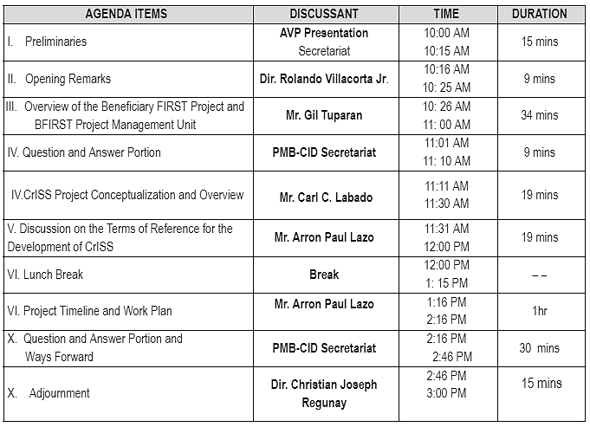
Program Sequence

Slide 8
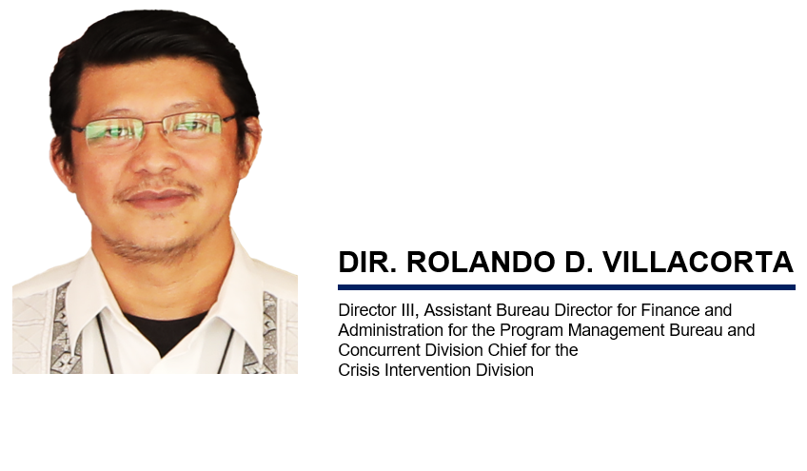
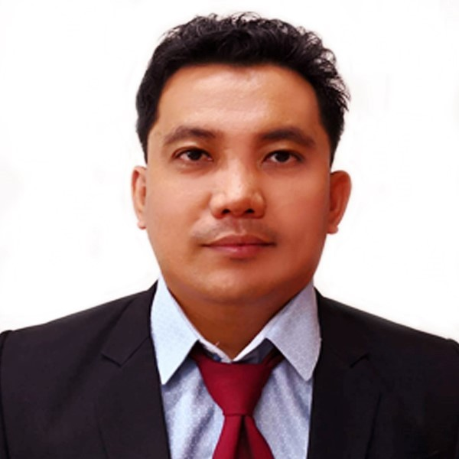
Opening Remarks:
ARTEMIO E. BAUTISTA, RSW, MSSW
Project Development Officer V, Unit Head, Crisis Intervention Unit

Slide 9
Overview of the Beneficiary FIRST Project and BFIRST Project Management Unit
MR. GIL R. TUPARAN
Beneficiary FIRST Project Secretariat and BFIRST Project Coordinator/Consultant

Slide 10
Question and Answer

Slide 12
CRISIS INTERVENTION SERVICES SYSTEM PROJECT OVERVIEW AND CONCEPTUALIZATION
MR. CARL C. LABADO
Information Technology Officer I, PMB-CID Planning, Monitoring and Evaluation Section-Information Technology and System Unit Lead

Slide 13
The CID ITSU was assigned to digitalize the modalities of the AICS program by formulating a technological solution that will enhance and improve the service delivery and operations of the AICS program.
The said team is part of the Crisis Intervention Division's Planning Monitoring and Evaluation Section, which served as the CID's primary focal/representative in all digital/technological engagement and discussion.
Notes:
The Assistance to Individuals in Crisis Situation Program (AICS) is one of the Department’s protective services targeting the poor, marginalized, vulnerable, or disadvantaged individuals and families.
Additionally, the program serves as a social safety net or a stop-gap mechanism to support the recovery of individuals and families from unexpected crises such as illness or death of a family member, natural and man-made calamities, and other crisis situations.
This is implemented by the Department’s Central Office and Field Offices’ One Crisis Intervention Unit, 16 Crisis Intervention Sections, 106 Social Welfare and Development (SWAD) Satellite Offices; and 151 Malasakit Centers.
The assistance from the AICS Program may be in the form of the following: Financial, Transportation, Medical, Burial, Food Assistance, and the PPE Assistance or Physical Protective Equipment assistance.

Slide 14
Notes:
The Assistance to Individuals in Crisis Situation Program (AICS) is one of the Department’s protective services targeting the poor, marginalized, vulnerable, or disadvantaged individuals and families.
Additionally, the program serves as a social safety net or a stop-gap mechanism to support the recovery of individuals and families from unexpected crises such as illness or death of a family member, natural and man-made calamities, and other crisis situations.
This is implemented by the Department’s Central Office and Field Offices’ One Crisis Intervention Unit, 16 Crisis Intervention Sections, 106 Social Welfare and Development (SWAD) Satellite Offices; and 151 Malasakit Centers.
The assistance from the AICS Program may be in the form of the following: Financial, Transportation, Medical, Burial, Food Assistance, and the PPE Assistance or Physical Protective Equipment assistance.

Slide 15
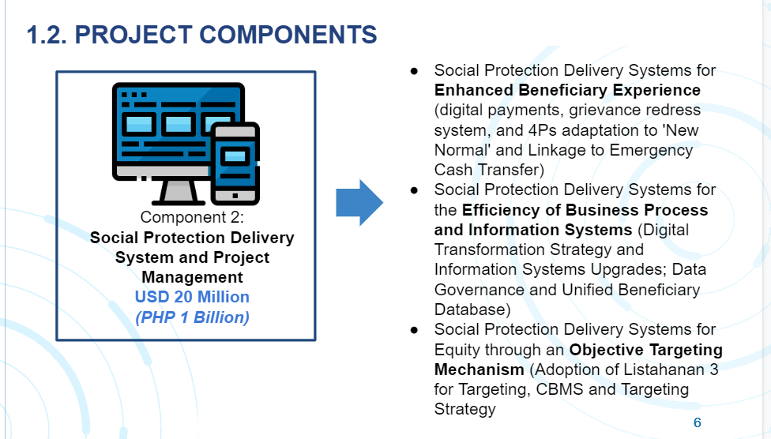
Notes:
The Assistance to Individuals in Crisis Situation Program (AICS) is one of the Department’s protective services targeting the poor, marginalized, vulnerable, or disadvantaged individuals and families.
Additionally, the program serves as a social safety net or a stop-gap mechanism to support the recovery of individuals and families from unexpected crises such as illness or death of a family member, natural and man-made calamities, and other crisis situations.
This is implemented by the Department’s Central Office and Field Offices’ One Crisis Intervention Unit, 16 Crisis Intervention Sections, 106 Social Welfare and Development (SWAD) Satellite Offices; and 151 Malasakit Centers.
The assistance from the AICS Program may be in the form of the following: Financial, Transportation, Medical, Burial, Food Assistance, and the PPE Assistance or Physical Protective Equipment assistance.

Slide 16
Project Overview
Project Conceptualization
PMB-CID, a member of the BFIRST Project Management Unit Component II under Special Order 3232 Series of 2022, is responsible for overseeing the completion of CrISS development.
Conducted PIR requesting for updated number of ICT Equipment of FOs
Enhancement of TOR and numerous Discussion with WB Approved TOR, PR Further comments from PMD, WB.
ITRA Certification from DICT; Uploading of CrISS to PhilGeps Portal;
Undergo with the process for Short of Award; Numerous meeting w/BAC Secretariat.
Submission of BFIRST ISSP
Presentation to TWG
Conducted Survey Crafting of CP/PP
Market Study Presentation to TWG Facilitation meeting with SB Submitted Approved PR Modification made: Single Procurement
Recalibration of
TOR, Uploading of CrISS TOR to WB STEP Portal No Objection Received from the Work Bank Approved PPMP 2023, APP 2023
Awarding of the evaluated and identified SDF; Inception Report of the SDF;
Commencement in Development CrISS with 12 months timeline
Market Study Presentation to TWG
Drafting of TOR and Presentation to TWG
Notes:
The Assistance to Individuals in Crisis Situation Program (AICS) is one of the Department’s protective services targeting the poor, marginalized, vulnerable, or disadvantaged individuals and families.
Additionally, the program serves as a social safety net or a stop-gap mechanism to support the recovery of individuals and families from unexpected crises such as illness or death of a family member, natural and man-made calamities, and other crisis situations.
This is implemented by the Department’s Central Office and Field Offices’ One Crisis Intervention Unit, 16 Crisis Intervention Sections, 106 Social Welfare and Development (SWAD) Satellite Offices; and 151 Malasakit Centers.
The assistance from the AICS Program may be in the form of the following: Financial, Transportation, Medical, Burial, Food Assistance, and the PPE Assistance or Physical Protective Equipment assistance.

Slide 17
CrISS Workplan
Notes:
The Assistance to Individuals in Crisis Situation Program (AICS) is one of the Department’s protective services targeting the poor, marginalized, vulnerable, or disadvantaged individuals and families.
Additionally, the program serves as a social safety net or a stop-gap mechanism to support the recovery of individuals and families from unexpected crises such as illness or death of a family member, natural and man-made calamities, and other crisis situations.
This is implemented by the Department’s Central Office and Field Offices’ One Crisis Intervention Unit, 16 Crisis Intervention Sections, 106 Social Welfare and Development (SWAD) Satellite Offices; and 151 Malasakit Centers.
The assistance from the AICS Program may be in the form of the following: Financial, Transportation, Medical, Burial, Food Assistance, and the PPE Assistance or Physical Protective Equipment assistance.

Slide 18
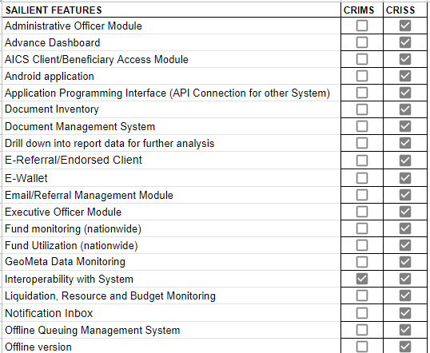
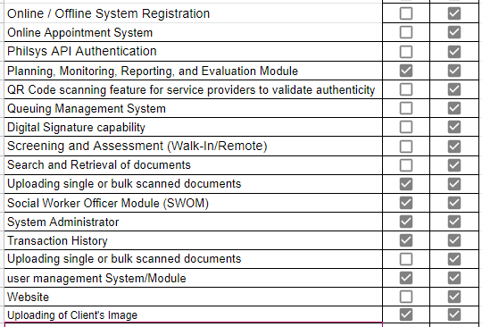
Comparative Presentation of the Crisis Intervention Monitoring System (CrIMS) and the Crisis Intervention Services System (CrISS)
Notes:
The Assistance to Individuals in Crisis Situation Program (AICS) is one of the Department’s protective services targeting the poor, marginalized, vulnerable, or disadvantaged individuals and families.
Additionally, the program serves as a social safety net or a stop-gap mechanism to support the recovery of individuals and families from unexpected crises such as illness or death of a family member, natural and man-made calamities, and other crisis situations.
This is implemented by the Department’s Central Office and Field Offices’ One Crisis Intervention Unit, 16 Crisis Intervention Sections, 106 Social Welfare and Development (SWAD) Satellite Offices; and 151 Malasakit Centers.
The assistance from the AICS Program may be in the form of the following: Financial, Transportation, Medical, Burial, Food Assistance, and the PPE Assistance or Physical Protective Equipment assistance.

Slide 19
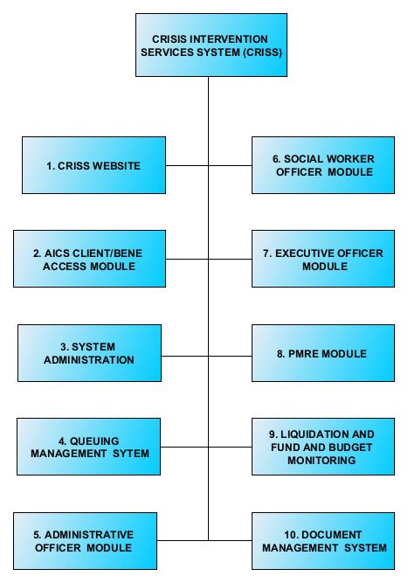
Crisis Intervention Services System (CrISS)
CrISS has ten (10) unique modules integrated in one system, established to perform a distinctive attribute that facilitates the efficient implementation of the AICS Program and to amalgamate the existing Crisis Intervention Monitoring System, which will help the CIU/CIS/SWAD Sattelite Offices and Malasakit Offices nationwide and continue positive development and actualizing the “ease of use” associated with the Ease of Doing Business Law (Republic Act. No. 11032).
Notes:
CrISS has ten (10) unique modules integrated in one system, established to perform a distinctive attribute that facilitates the efficient implementation of the AICS Program and to amalgamate the existing Crisis Intervention Monitoring System, which will help the 274 government offices that are implementing the program nationwide and continue positive development and actualizing the “ease of use” associated with the Ease of Doing Business Law (Republic Act. No. 11032).

Slide 20
Discussion on the Terms of Reference for the Development of CRISS
MR. ARRON PAUL D. LAZO Project Development Officer II, PMB-CID Planning, Monitoring and Evaluation Section-Information Technology and System Unit Focal Person

Slide 21
Discussion on the Terms of Reference for the Development of CRISS
CRISS TOR has 17 versions, and the latest version was approved dated 09 February 2023.
The Placement of advertisement was posted on the Philippine Government Electronic Procurement System (PhilGEPS), DSWD Website, Systematic Tracking of Exchanges in Procurement (STEP) Website, and UNDP website from 21 February 2023 to 06 March 2023. The deadline for submission application was by 06 March 2023
In response to the REOI, a total of thirteen (13) responses were received. Out of 13 consulting firms, only seven got the qualified score to be placed on the shortlist, and based on the result of the REOI, the Evaluation Committee would recommend inviting the shortlisted firms to submit their proposals.
Amendments to the CRISS TOR must be approved by the BFIRST Project Director before proceeding with the technical evaluation.

Slide 23
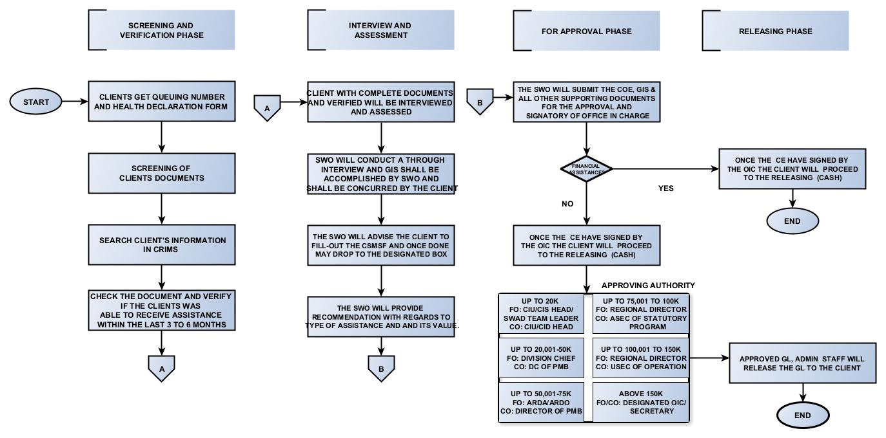
AICS Revised Process Flow

Slide 24
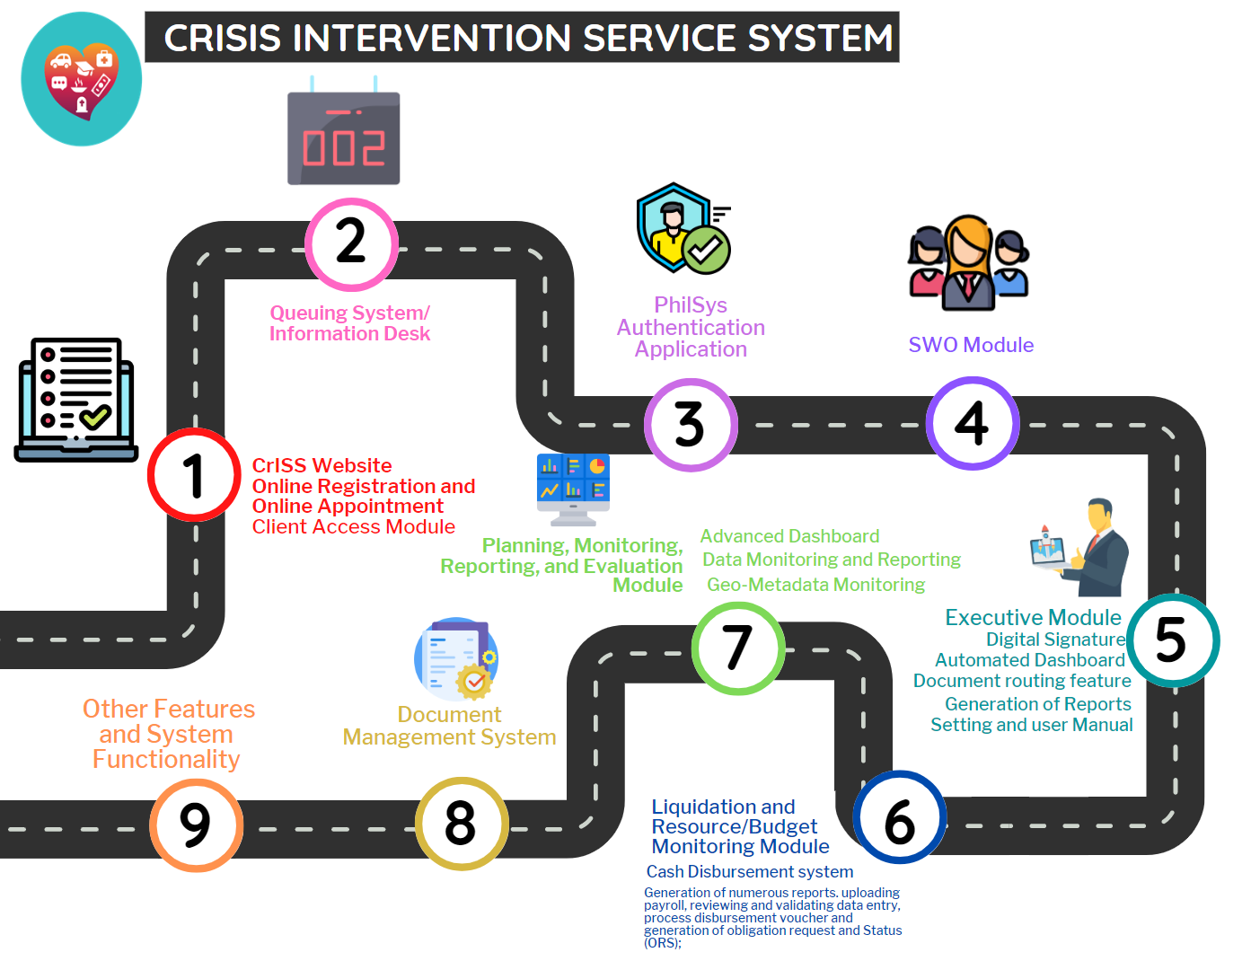
CURRENT PROCESS OF AICS PROGRAM

Slide 26
Question and Answer

Slide 27
Other Matters and Ways Forward

Slide 29
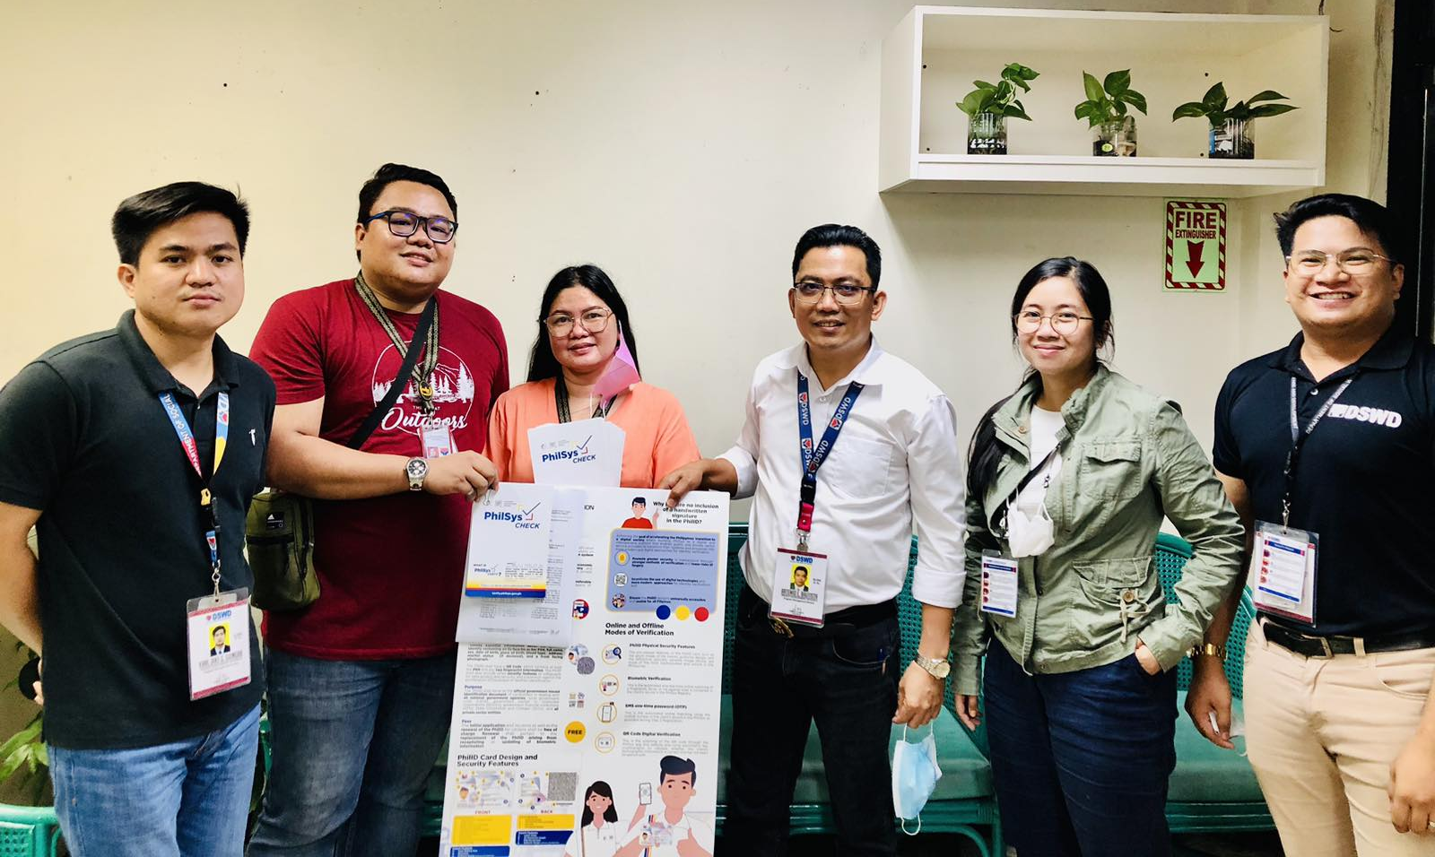
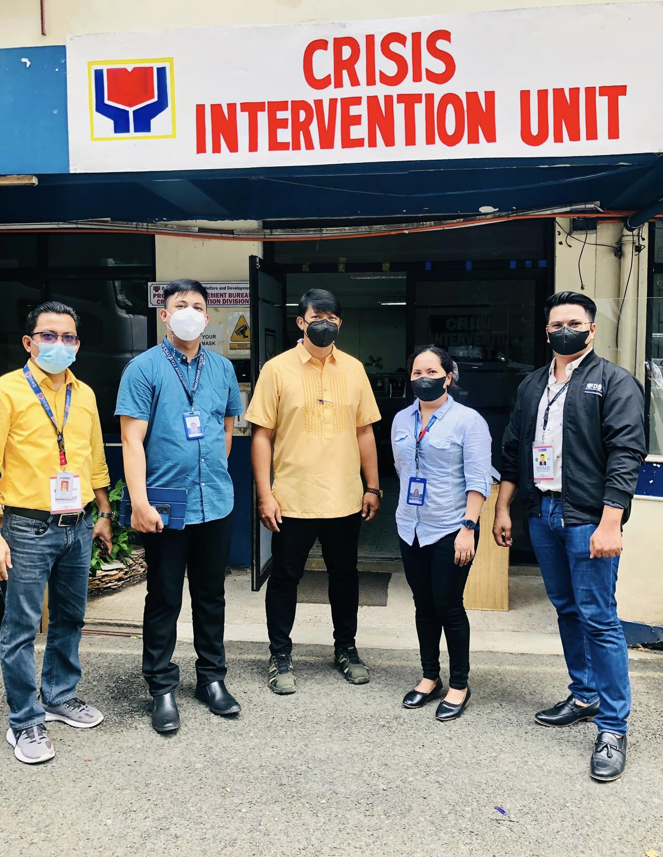
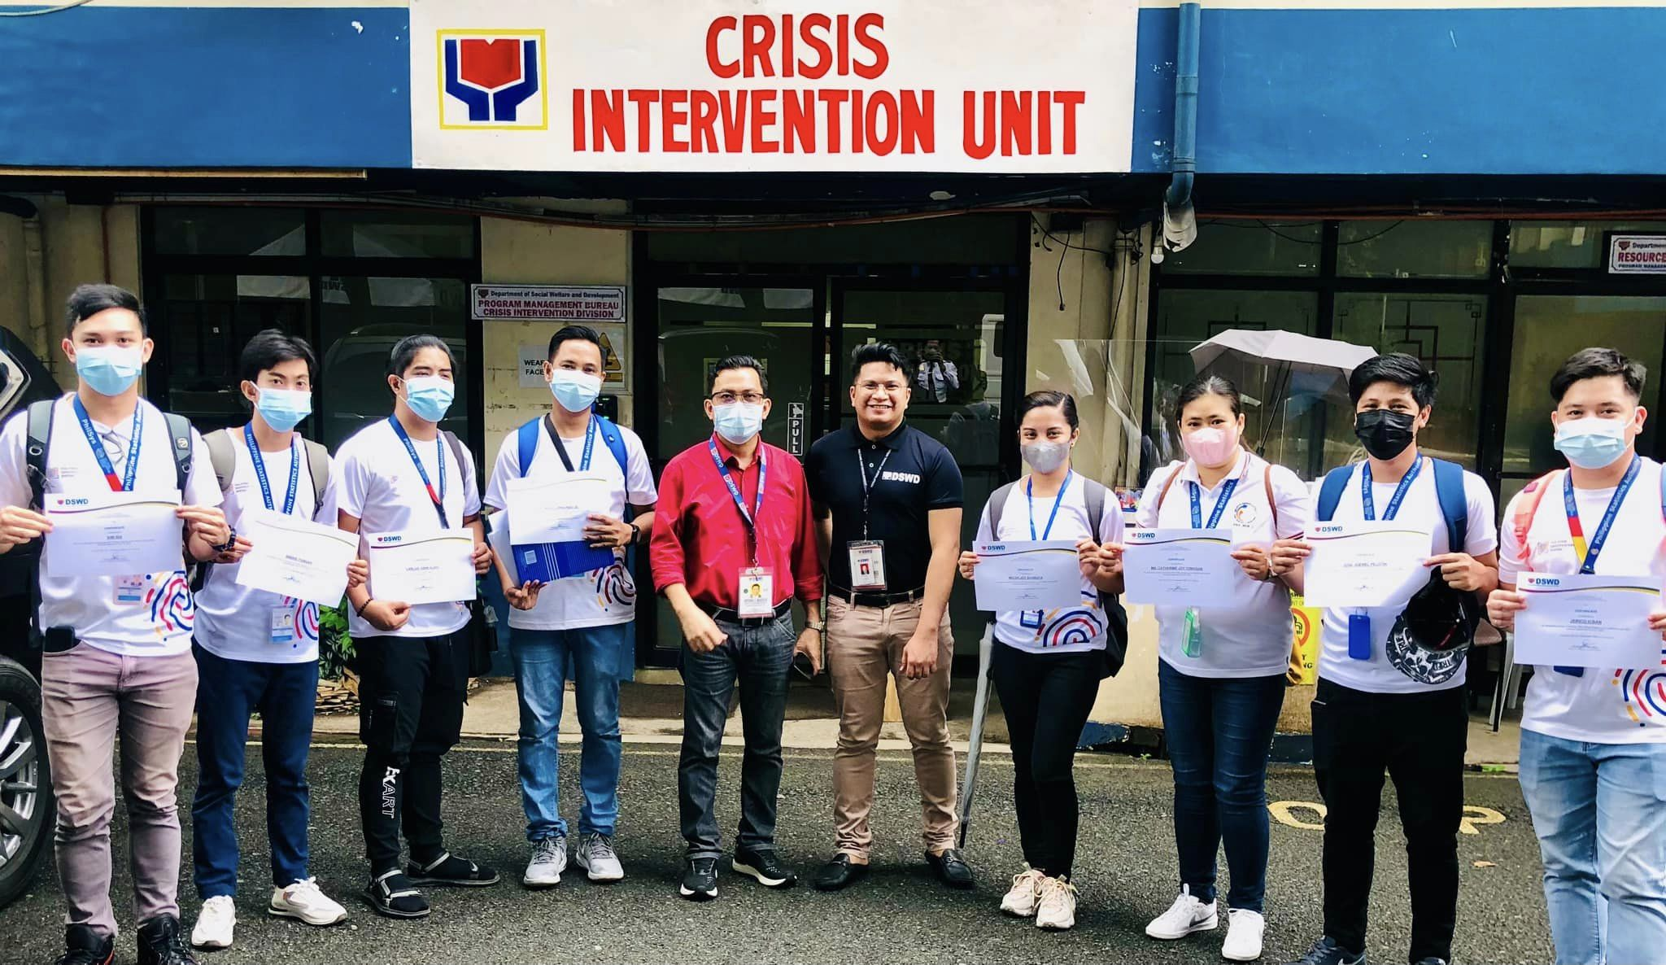
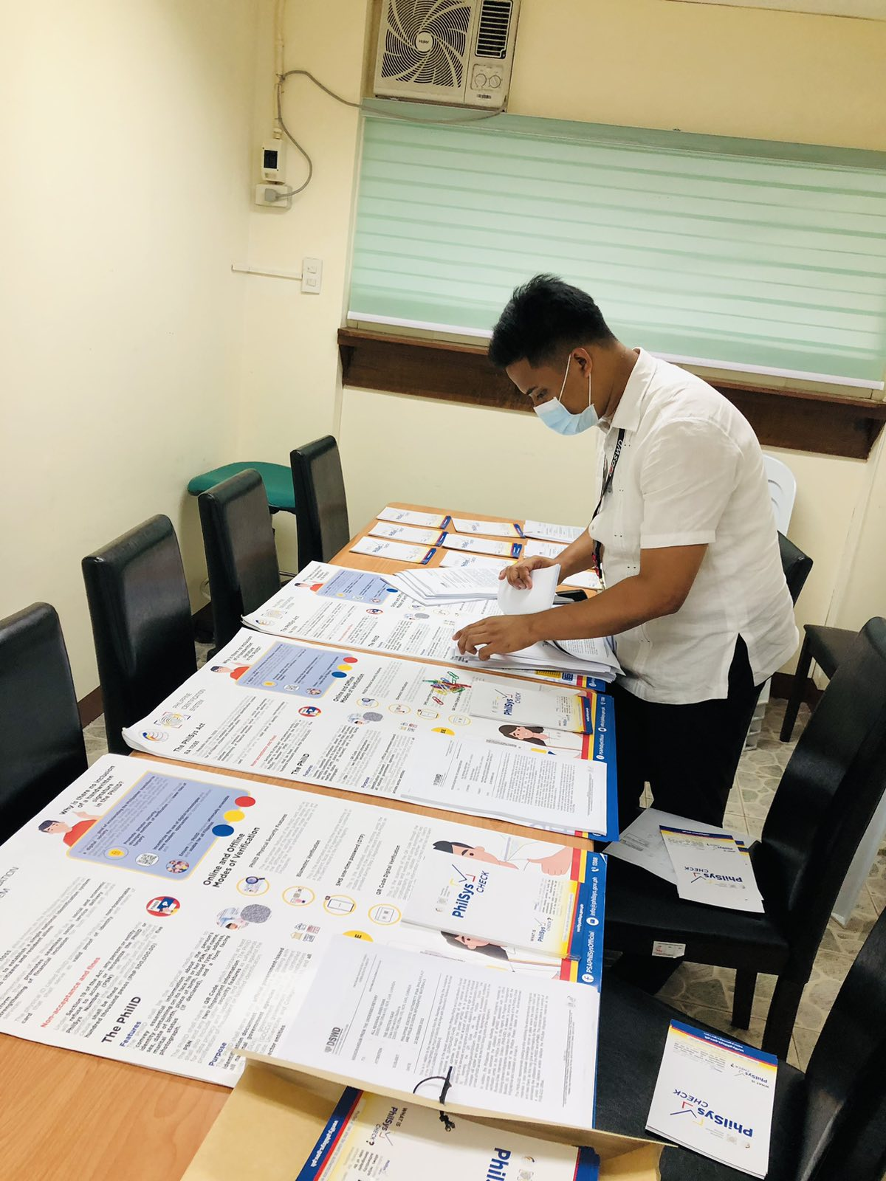
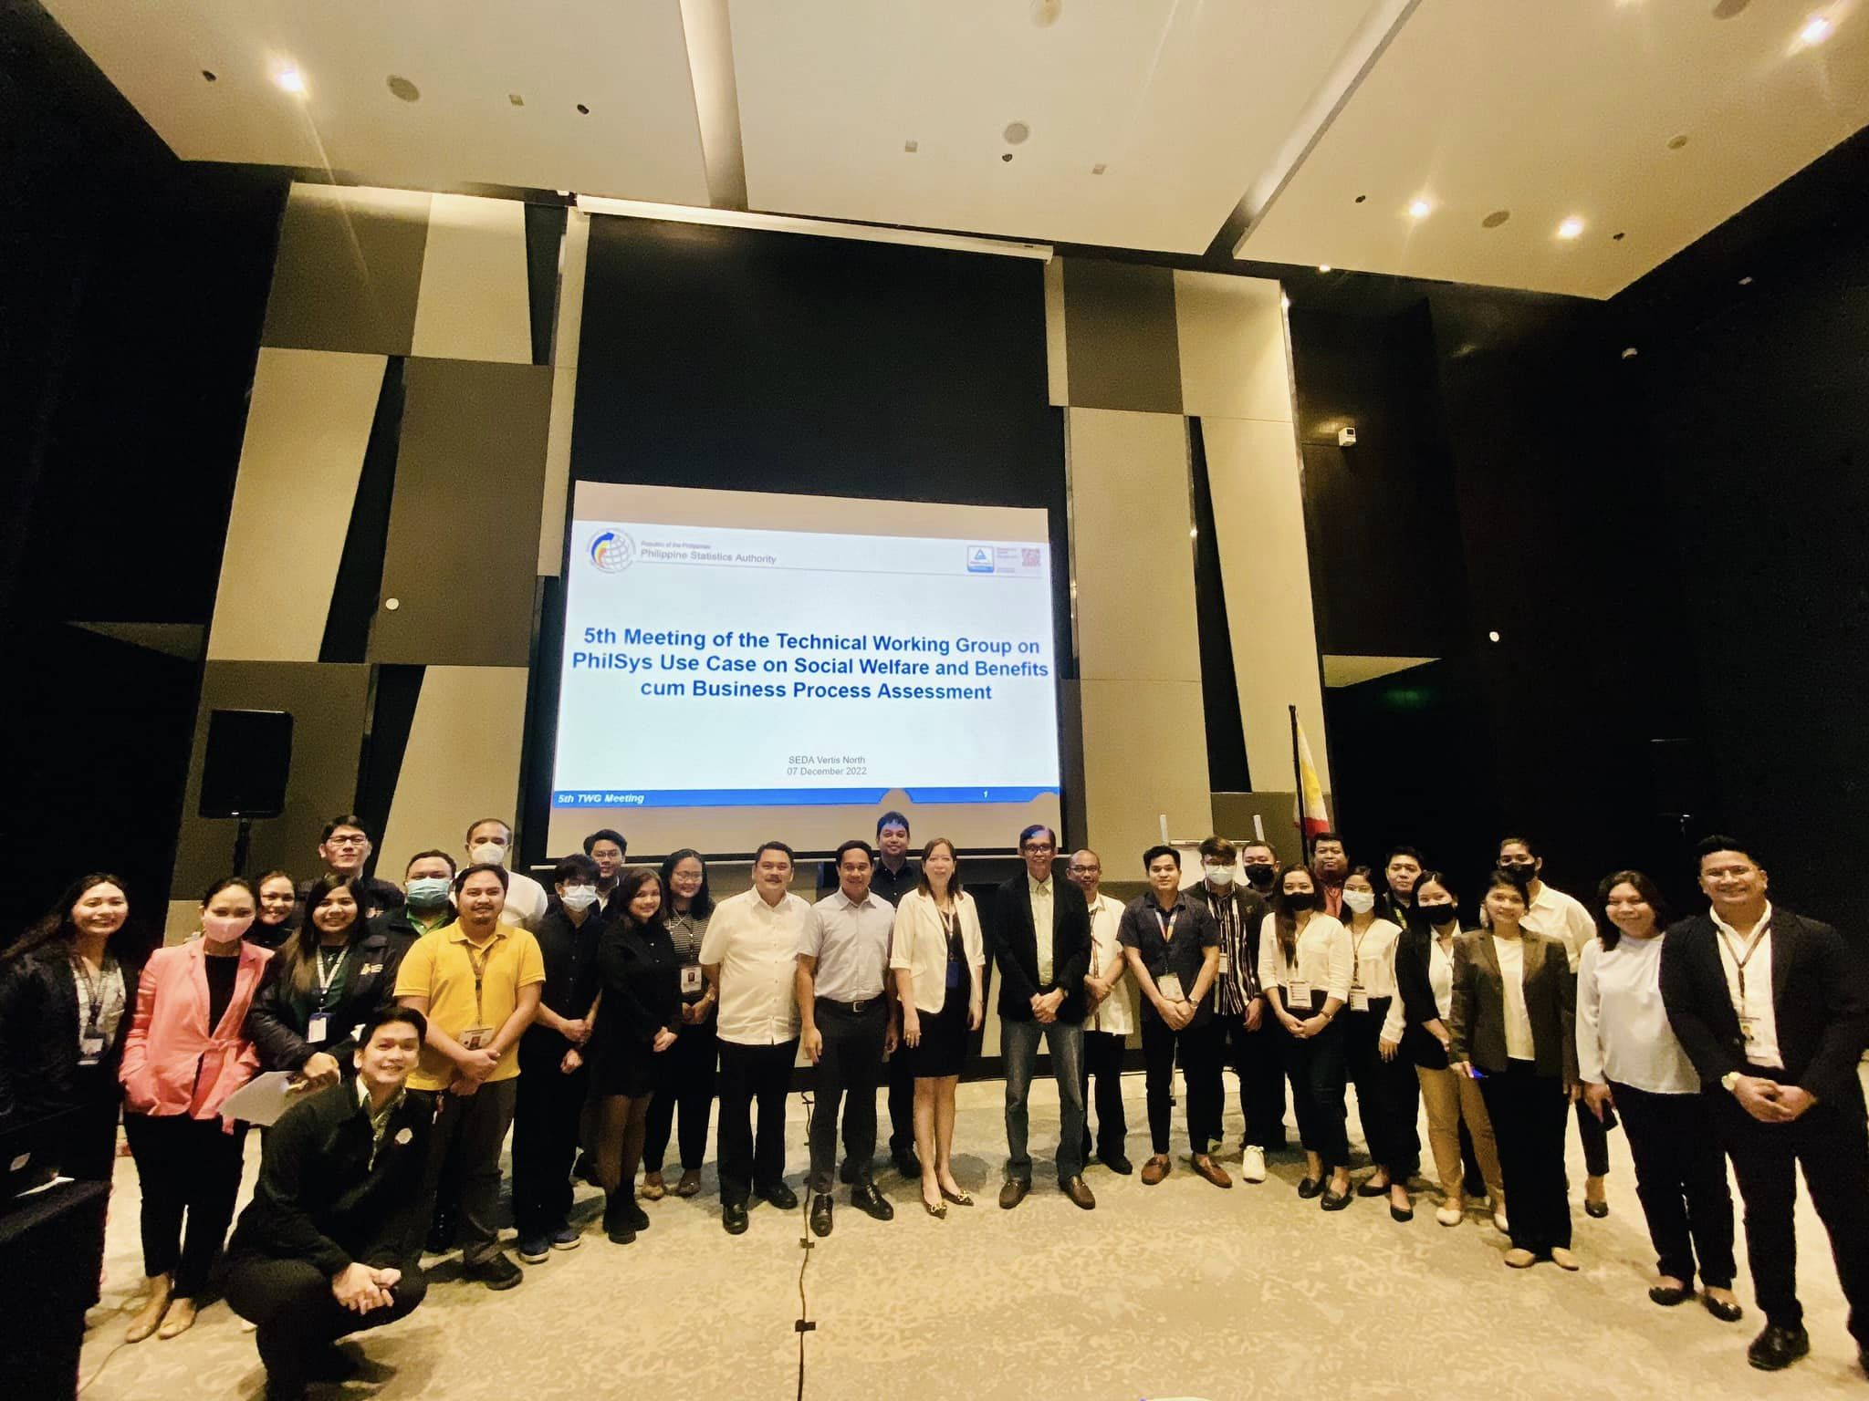
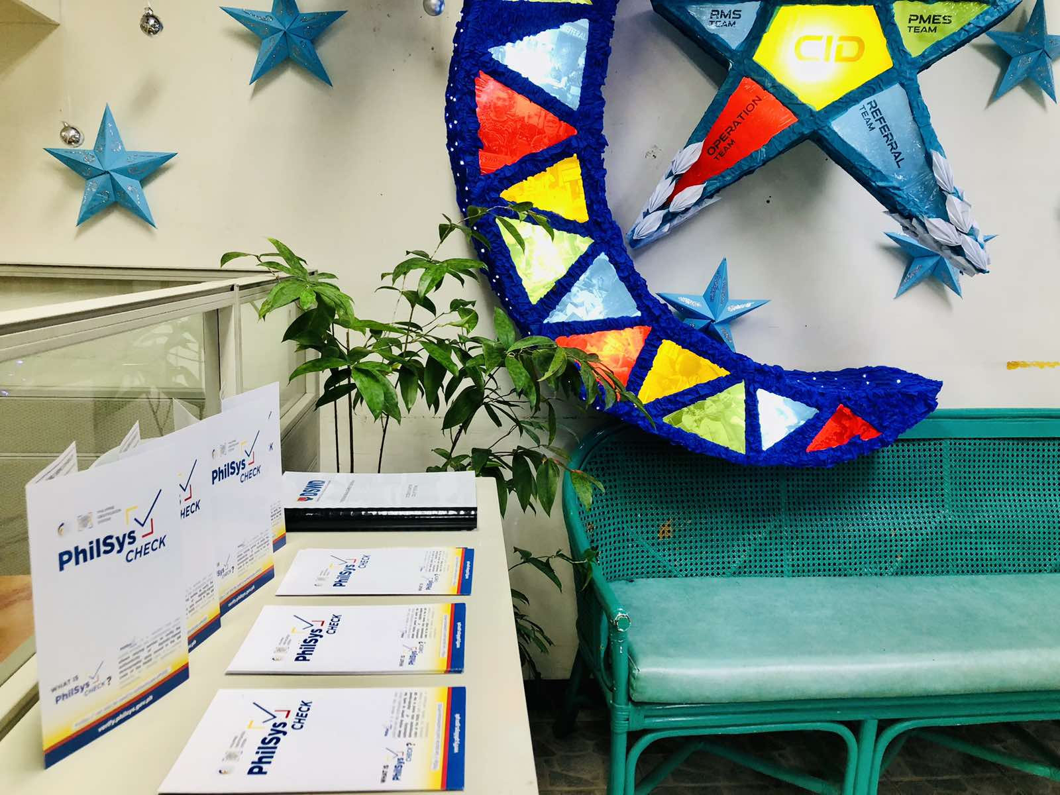
Other Updates and Initiatives to support the Implementation of CrISS
September 30, 2022 PhilSys Summit
On 05 January 2023, the PMB-CID shared infographic materials to DSWD Field Office NCR Crisis Intervention Section
PSA Ocular visit at DSWD Central office
PhilSys Registry at DSWD Central Office (Last Day)
Distribution of PhilSys Infographic Materials
5th TWG meeting with all the proponent of the saidprokwc/

Slide 30
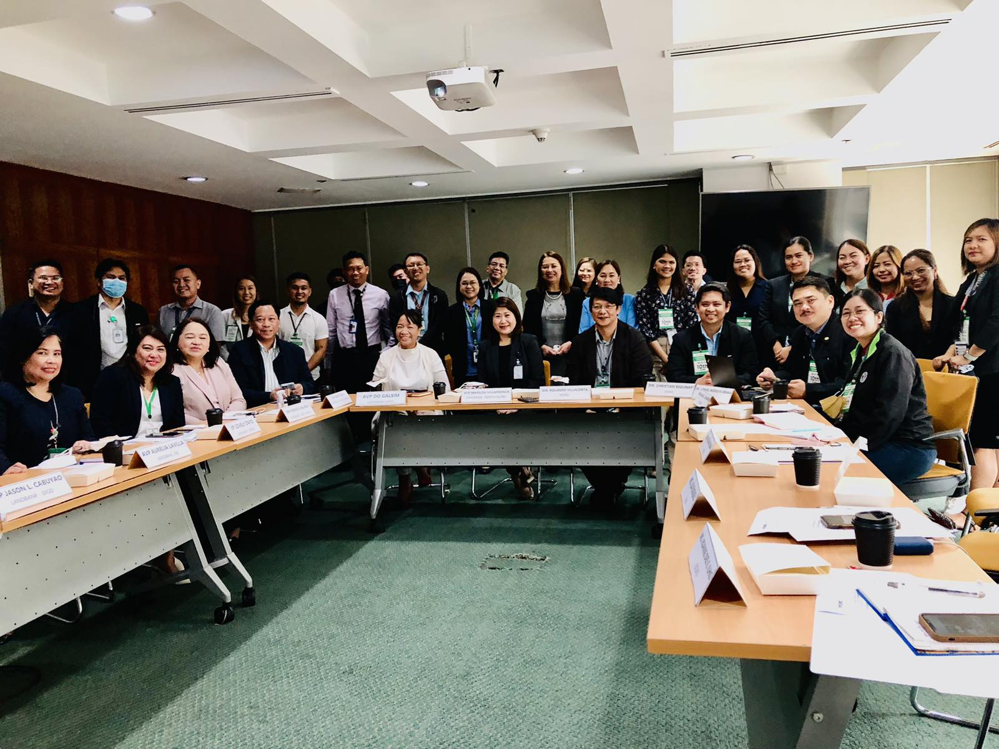
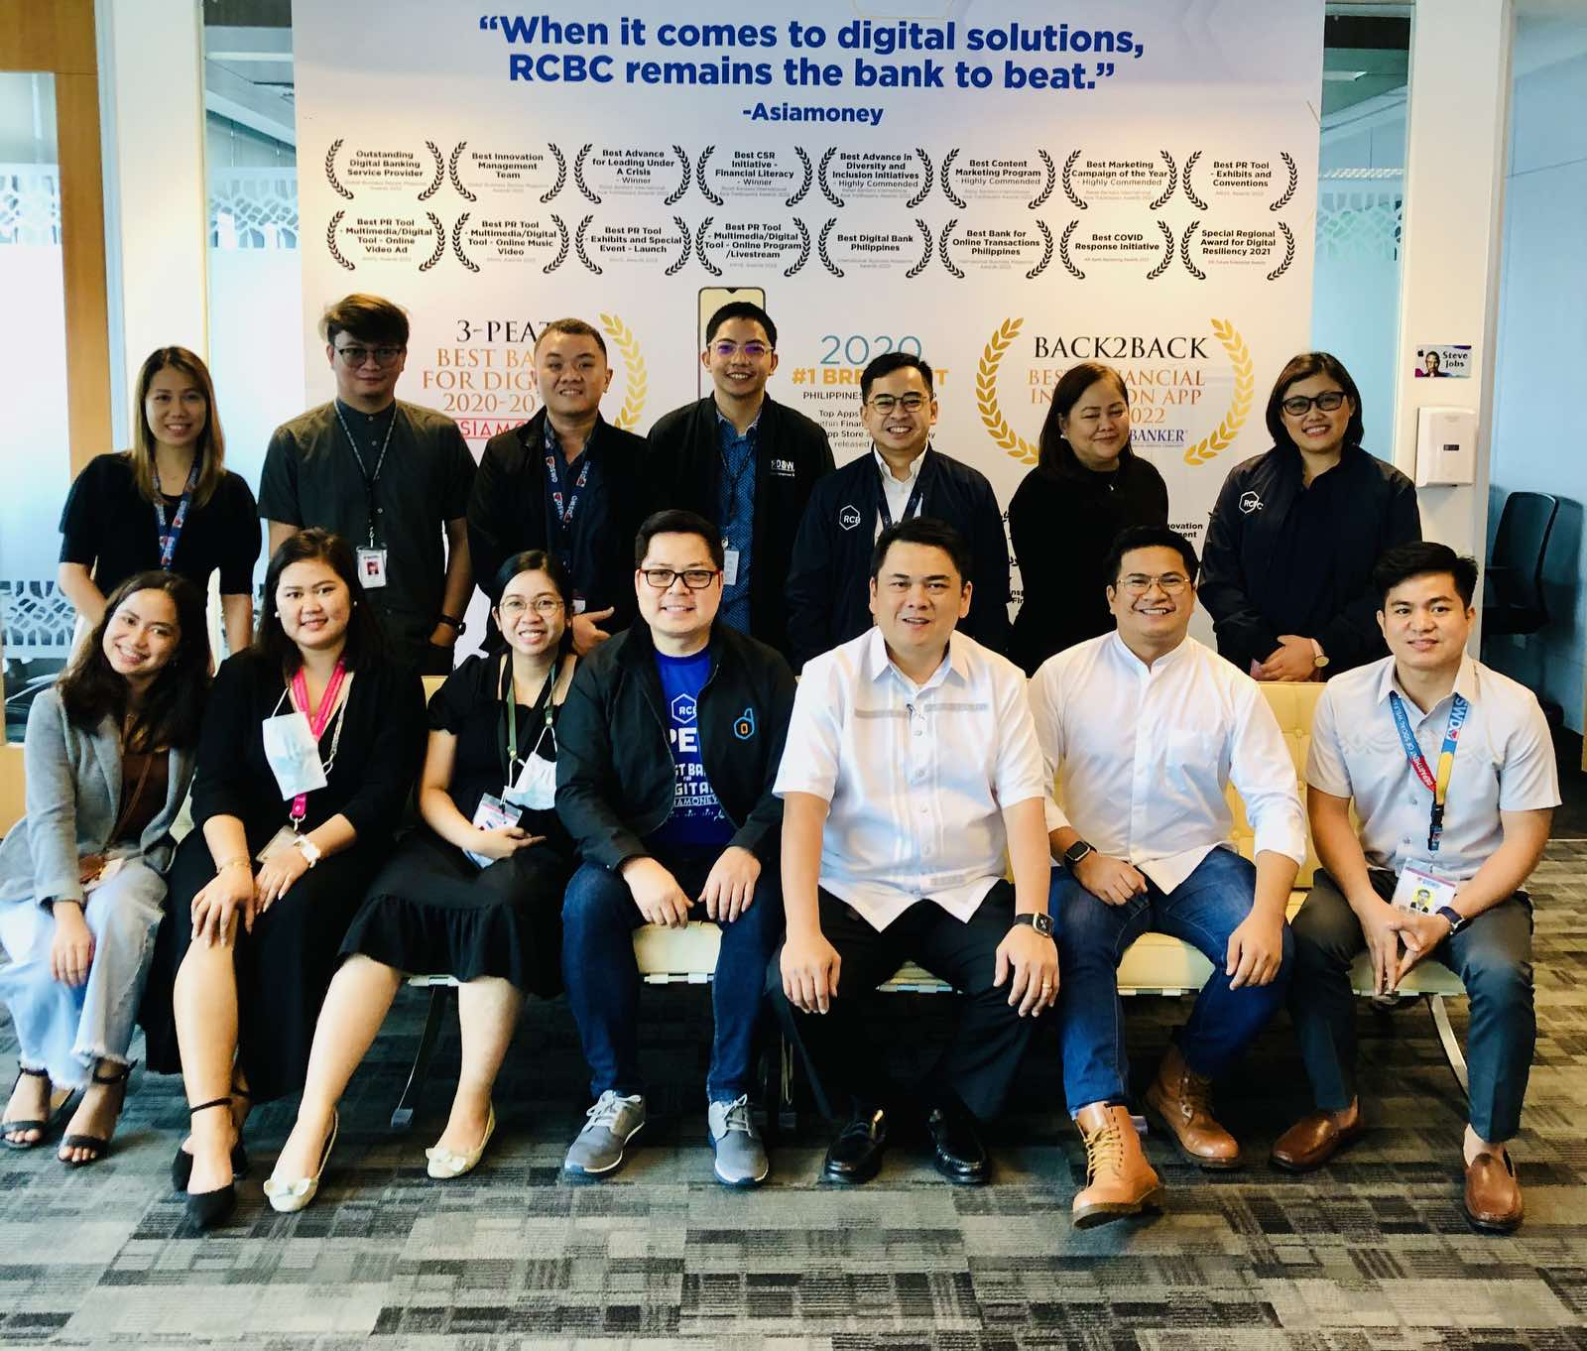
Other Updates and Initiatives to support the Implementation of CrISS
September 30, 2022 PhilSys Summit
On 17 January 2023, Technical Discussion with LBP Executive Officer discussing the CRISS E-Payment Scheme with the LBP’s Payout Channels
Learning and/or Exploratory Meeting with RCBC at their main office.

Slide 31
Other Matters and Ways Forward
Request to have at least one focal person and/or representative from your field office, preferably an implementer of the AICS Program who has the expertise in executing the services of the program, such as a social welfare officer or an IT officer, who can perform and facilitate the echoing of the information and/or discussion relative to the CrISS Project
CRISS Training for Trainers;
assist in conducting pilot testing, providing reports, (e.g. feedback reports)
focus on distributing the ICT equipment;
involvement with the other system development projects of the CO;
Amplifying the voice of their respective organizations, providing reports and the current status of the CRISS system and other IS and ICT equipment, and sharing their issues and concerns;
Other activities, trainings, and seminars;
Discussion with Digital Payments TWG
Discussion with the Land Bank of the Philippines
Learning visit the Municipality of the Valenzuela
Discussion with BSP (tentative)
Learning visit with the DICT (tentative)
Orientation with World Bank with regard to the Time and Motion Study of PhilSys use case.
A site visit to the identified Crisis Intervention Sections and SWAD Satellite Offices will be conducted by the PMB-CID to gather relevant information, status, and observations that will be shared with the identified service provider who will develop the CrISS in April 2023. (tentative)

Slide 32
Closing Remarks:
DIR. CHRISTIAN JOSEPH M. REGUNAY
Director III, Assistant Service Director for the Information Communication Technology Management and Service and Concurrent ABD for the Social Technology Bureau

