Slide 1
PROCESS EVALUATION OF THE ASSISTANCE TO INDIVIDUALS IN CRISIS SITUATION (AICS)
Policy and Plans Group Cluster Meeting
13 July 2021, 8:00AM
Meeting link:
24 January 2023 Via Google Meet

Slide 2
OUTLINE OF PRESENTATION
Introduction
Methodology
Key Findings
Key Recommendations
PROCESS EVALUATION OF THE AICS

Slide 3
INTRODUCTION
PROCESS EVALUATION OF THE AICS

Slide 4
Rationale
INTRODUCTION
The program has been implemented for a significant period of time thus the need to review the program elements and its overall impact.
To narrow down on the program issues and challenges, detail out the causes and different parties for each gaps or lapses presented .
PROCESS EVALUATION OF THE AICS
Notes:
Ever since program inception, no evaluation studies have been conducted covering all the assistance under AICS.
Follow-through to the directive of the Secretary to ENSURE EXECUTION OF THE DSWD POLICY AGENDA, AND DSWD RESEARCH AND EVALUATION AGENDA during the NMDC last January 2022
An output of the Coaching and Mentoring Sessions of the Rollout of the National Evaluation Policy Framework (NEPF)

Slide 5
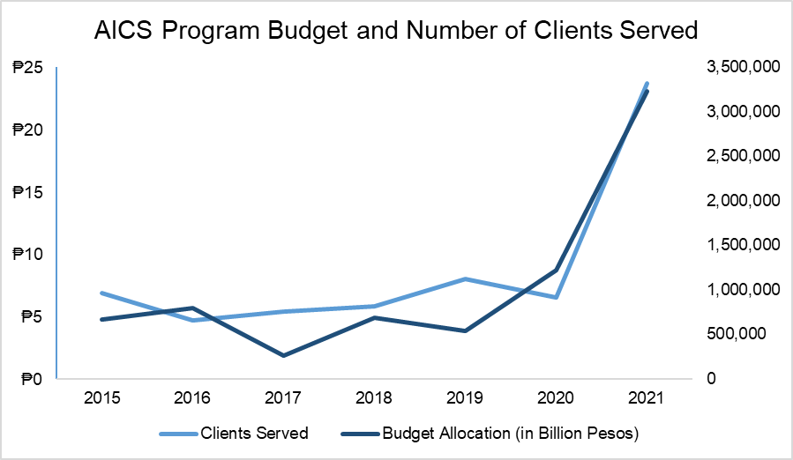
Rationale
INTRODUCTION
Continuing increase in budget allocation and number of clients served
PROCESS EVALUATION OF THE AICS
Notes:
Some of the issues and challenges gathered by the evaluation team are..
The continuing increase in budget allocation and number of clients served can be observed in the figure. In 2021, the AICS Program has provided to 3.3 million clients with an assistance amounting to Php 23.1 billion nationwide. This is 262% increase in the number of clients served compared to the previous year.
Further, the program targets have been consistently exceeded since 2014. For 2021, the accomplishment deviated from the target by almost 300% (three times higher than the target). From 2016 to 2018, the three-year average number of clients served is around 740,000. In the next three years, this increased to 42% or 1.8 million average number of clients served from 2019 to 2021. Consequently, the program’s augmentation of fund support to beneficiaries has also exponentially increased to up to one hundred fifty thousand pesos (P150,000) in 2021, depending on the circumstance of the individual or family.

Slide 6
Rationale
INTRODUCTION
Increasing number of Audit Observations on AICS documented by the Commission on Audit (CoA)
2021 Integrated Performance Review and Evaluation Workshop (IPREW) Report from the Field Offices also revealed related lapses and deficiencies
PROCESS EVALUATION OF THE AICS
Notes:
In terms of actual operations, the Commission on Audit (CoA), in its 2021 report, cited deficiencies in around Php 148.8 million worth of funds distributed under the AICS. Some of the lapses and deficiencies found by state auditors were (a) non-observance of review and screening process in the granting of AICS; (b) series of assistance to single beneficiary; (c) lack of formal partnership with service providers; (d) failure to issue guarantee letter to service providers; (d) non-maintenance of Crisis intervention Management System (CrIMS) of AICS; and (e) non-observance of review and screening process in the granting of assistance.
The 2021 Integrated Performance Review and Evaluation Workshop (IPREW) Report from the Field Offices also revealed related lapses and deficiencies such as: (1) various pay-out concerns (lack of manpower; high security risk of SDOs/paymaster during encashment, transportation and disbursement of cash advance; and slow processing of liquidation); (2) challenges in timely preparation of liquidation report given the huge amounts to be disbursed; (3) recurrent outage of Crisis Intervention Monitoring System (CrIMS) which causes delay in the updating and encoding of clients served that may lead to duplication of services among FOs; (4) lack of monitoring on cases referred to CIU to account the services provided to different sectors; (5) lack of integrated cash monitoring system; (6) various HR-related concerns (voluminous work vis-a-vis the limited workforce; limited workspace to accommodate the staff, office equipment and documents; lack of security of tenure of field staff); and (7) significant increase of clients seeking assistance

Slide 7
Objectives of the Study
INTRODUCTION
Assess the AICS program design, delivery mechanisms, processes, performance, as well as beneficiary awareness and effects;
Assess the AICS in terms of its relevance, coherence, effectiveness, efficiency, sustainability and potential impact; and
Provide program management evidence-based information to make program design and implementation adjustment decisions and to modify and update policies and guidelines.
PROCESS EVALUATION OF THE AICS
Notes:
With the mentioned initial issues and findings, it can be gleaned that there is a need to conduct process evaluation of the implementation of AICS.

Slide 8
Scope and Limitations
INTRODUCTION
Regions with highest number of clients served per island cluster:
Luzon - Region II and NCR
Visayas - Region VI
Mindanao - Region XI
+
DSWD Central Office
PROCESS EVALUATION OF THE AICS
Notes:
Due to limitations in research budget and number of evaluation team members, the PE only covered the AICS implementation in DSWD Crisis Intervention Units/Sections (CIU/CIS) with highest number of clients served per island cluster (Region II and NCR for Luzon, Region VI for Visayas, and Region XI for Mindanao). Additionally, the AICS implementation in the DSWD Central Office was also covered.
To reduce recall bias or inability of respondents to recall events and feelings, only the AICS clients or beneficiaries served from 2019 to present were targeted for the survey and focus group discussions. Clients refer to the individual or family who physically appeared at a CIU or SWAD or before a social worker to process the required assistance. The client may be the beneficiary him/herself or the authorized representative of the beneficiary. Beneficiaries refer to the actual recipient of the funds or the benefits of AICS. The terms “beneficiaries” and “clients” will be used interchangeably throughout this report for easy reference.

Slide 9
METHODOLOGY
PROCESS EVALUATION OF THE AICS

Slide 10
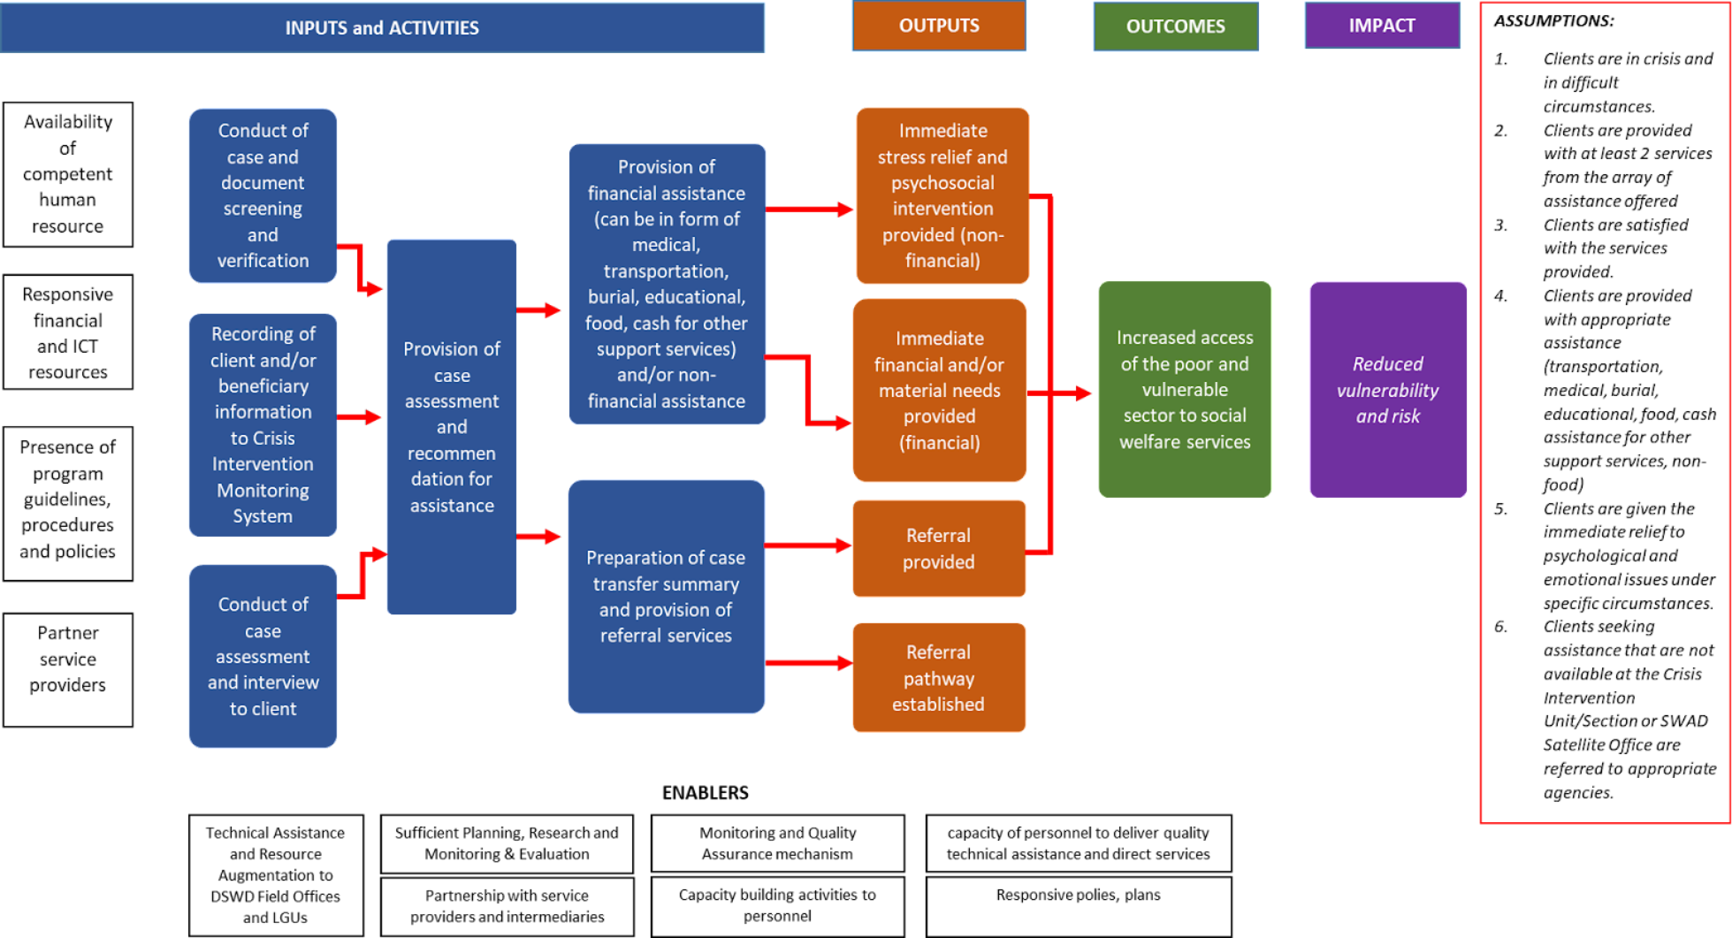
THEORY OF CHANGE
PROCESS EVALUATION OF THE AICS
Notes:
As I have mentioned earlier, one of the objectives of the study is to assesses the AICS in terms of its relevance, coherence, effectiveness, efficiency, sustainability and potential impact. Each criterion is operationalized in more detail using key evaluation questions. To be able to do this, there is a need to revisit first the AICS ToC.
However, the AICS Program has no established theory of change (ToC) during the inception phase of this study. During the UNDP-NEDA Roll-out activity of the National Evaluation Policy Framework (NEPF) Guidelines, the DSWD participants led the reconstruction of the program’s ToC and its validation with the DSWD Management.
Further, for the purpose of this study, the evaluation team shared and validated the ToC with the Central Office CIU staff in one of the consultation meetings during the preparatory phase.
The narrative of the ToC is: If individuals and families in crisis situations are provided with social welfare interventions through the AICS Program, Then the client’s well-being will be improved and access to social welfare services will be increased. This is because of the immediate provision of stress relief, psychosocial intervention, financial and/or material assistance, and referral services established, Therefore, the persons in crisis will be supported and assisted to prevent them from being poorer or going to the next level of poverty and be provided of certain level of empowerment.

Slide 11
METHODOLOGY
Desk Research Survey KII FGD
PROCESS EVALUATION OF THE AICS
Notes:
The process evaluation used qualitative and quantitative approaches to gather data from the AICS beneficiaries, program implementers and service providers. The qualitative approach involved collecting and analyzing primary data, consisting of key informant interviews (KII) and focus group discussions (FGDs). The main source of quantitative data was based on the primary data collected from the survey.
All of the data gathering tools used in the study including the guide questionnaires and survey form (see Annex 1, 2, and 3) were pre-tested in Baguio City, Cordillera Administrative Region.

Slide 12
METHODOLOGY
TARGET GROUPS
DATA COLLECTION
AICS Beneficiaries/ Clients Served from 2019 to 2022
473 respondents surveyed and 24 FGDs conducted
AICS Implementers
(CIS and SWAD staff, RD/ARDO)
12 KIIs and 6 FGDs
Partner Service Providers
14 KIIs
PROCESS EVALUATION OF THE AICS

Slide 13
KEY FINDINGS
PROCESS EVALUATION OF THE AICS

Slide 14
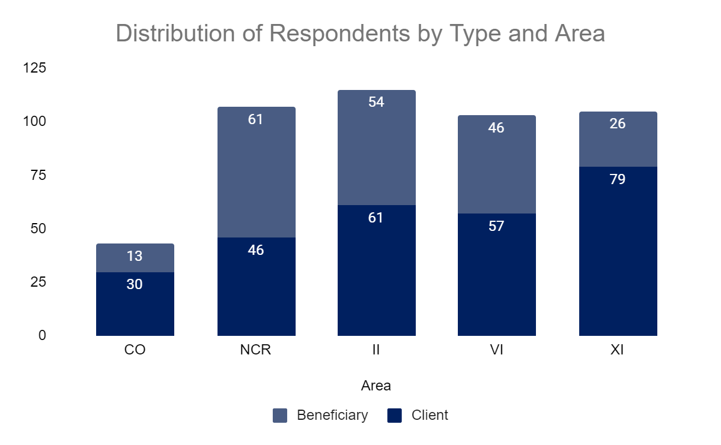
Profile of Survey Respondents
KEY FINDINGS
PROCESS EVALUATION OF THE AICS
Notes:
A total of 473 respondents participated in the survey. Majority or 57.7% are clients, whereas 42.3% are beneficiaries.

Slide 15
Profile of Survey Respondents
KEY FINDINGS
Type of Assistance | No. of First-time Clients | No. of Repeat Clients (at least 2 times)
Medical | 168 | 195
Burial | 69 | 4
Transportation | 5 | 0
Education | 16 | 8
Food | 18 | 6
Cash | 40 | 2
Total | 316 | 215
PROCESS EVALUATION OF THE AICS
Notes:
A great majority or 316 (60%) of the total respondents were first-time clients. Meanwhile, respondents who have already been clients before for at least two times availed the medical assistance the most.

Slide 16
Profile of Survey Respondents - Clients
KEY FINDINGS
Median Age: 46 yrs old
78%
22%
Civil Status
367 Females
106 Males
422 aged 15-64
44 aged 65 and over
52% married
21% single
11% widow/widower
10% living together with partners
PROCESS EVALUATION OF THE AICS
Notes:
Majority or 367 (78%) of the respondents are females while 106 (22%) were males.
The median age of the respondents was 46 years old. Persons aged 15 to 64 years (working age or economically active) totaled to 422 (89%) while those in age groups 65 years and over (old dependents) comprised the remaining 44 (9%). The remaining 7 (2%) respondents did not report their age.
More than half (52.0%) of the respondents are married while 21% are single. 11% of the respondents are widow/widower and almost 10.0% are living together with their partners.

Slide 17
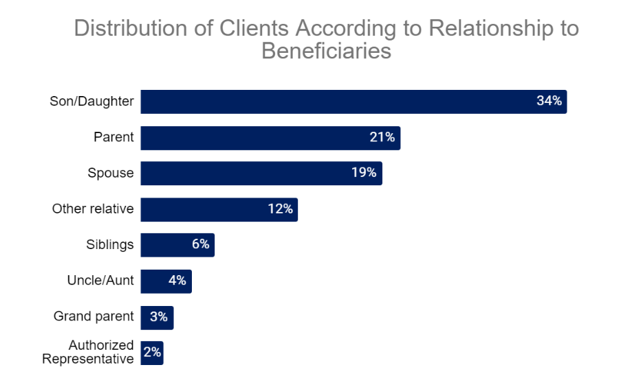
Profile of Survey Respondents - Clients
KEY FINDINGS
PROCESS EVALUATION OF THE AICS
Notes:
Among the client respondents, 34% are children of the beneficiaries, while 21% are parents of the beneficiaries and 19.0% are spouses of beneficiaries needing the assistance.

Slide 18
Profile of Survey Respondents - Beneficiaries
KEY FINDINGS
Distribution of Beneficiaries by Top 5 Sector and Area
Sector | CO | NCR | II | VI | XI | Total
 |  |  |  |  |  | No. | %
Urban/Rural Poor | 18 | 33 | 61 | 24 | 30 | 166 | 24%
Women | 15 | 41 | 53 | 31 | 24 | 164 | 24%
Senior Citizen | 11 | 24 | 44 | 28 | 37 | 144 | 21%
Children | 6 | 13 | 7 | 11 | 17 | 54 | 8%
PWD | 4 | 12 | 9 | 12 | 10 | 47 | 7%
PROCESS EVALUATION OF THE AICS
Notes:
The urban/rural poor represent 24% of the respondents who are the primary beneficiaries of assistance. The highest percentage (37%) of urban/rural poor respondents reside in Region II. It was evident that women and senior citizen respondents availed themselves of assistance the most across all regions that have been surveyed. The greatest share of women and senior citizen beneficiaries can also be found in Region II at 26% and 29% of the total respondents, respectively. This was followed by NCR at 27% and 22%.

Slide 19
Profile of Survey Respondents - Beneficiaries
KEY FINDINGS
Average Household Size
18-59 yrs. old
with an illness
has functional limitation
5 members
with a source
of income
senior citizen
PROCESS EVALUATION OF THE AICS
Notes:
The average household size of the respondent beneficiaries is five with three members aged 18-59 years old.
Across all the regions covered, respondents mentioned that at least one member has a functional limitation, one to two members are with an illness, and one is a senior citizen. However, only one to two members are with a source of income.

Slide 20
Pre-Assistance Situation - Average Household Income
KEY FINDINGS
Average Household Monthly Income by Source
Source of Income | CO | NCR | II | VI | XI | Overall Average
Work | 12,441.62 | 13,543.36 | 12,196.11 | 10,640.68 | 12,693.24 | 12,333.08
Livelihood | 6,190.00 | 5,428.57 | 6,948.08 | 6,661.29 | 9,173.33 | 6,715.00
Remittances | 8,360.00 | 3,840.00 | 5,470.59 | 6,571.43 | 27,502.25 | 8,158.13
Government Transfer | 500.00 | 1,812.50 | 937.50 | 3,245.00 | - | 1,855.36
Private Pension | 4,450.00 | 2,600.00 | 3,383.33 | 3,706.67 | 2,416.67 | 3,324.24
Gift | 2,300.00 | 8,458.33 | 5,044.44 | 4,600.00 | 5,750.00 | 6,171.88
Total | 10,271.67 | 11,067.40 | 10,684.52 | 9,624.76 | 11,895.21 | 10,769.21
PROCESS EVALUATION OF THE AICS
Notes:
Average Household Income. The average monthly household income of the respondents is estimated at Php10,769.21. Households from Region XI have the highest reported monthly income at Php11,895.21, while the smallest household income was observed in Region VI at Php9,624.76.
Respondents were also asked on the main source of income of the households. Majority of the respondents or 54% primarily depend on salaries and wages from employment as a source of income. The average reported income from salaries and wages is estimated at Php12,333.08. This was followed by livelihood from family-operated enterprises or activities at 20.8%, remittances or cash received out of salaries or wages from a family member at 7.6%, and private pension at 6.49%. Those who received government cash transfers like social pension and 4Ps accounted for 5.4% of the respondents. Less than 1% had no other source of income.

Slide 21
Pre-Assistance Situation - Income vs. Expenditure
KEY FINDINGS
Php10,769.21
Php12,639.28
PROCESS EVALUATION OF THE AICS
Notes:
Average Household Expenditure. The average monthly household expenditure of the respondents is estimated at Php12,639.28 . There is evidently a gap between the average household monthly income and expenditure. This validates that the respondents are in a crisis situation. The respondents spent mostly on food and groceries at an average cost of Php6,480.27 and medical needs at Php4,305.31. Households with members attending school reported expenditures on educational needs at php3,446.31.

Slide 22
AICS Program Availment
KEY FINDINGS
Number of Respondents Who Availed AICS per Type of Assistance
Type of Assistance | No. of Clients | Percent
Medical | 363 | 77%
Burial | 73 | 15%
Cash | 42 | 9%
Education | 24 | 5%
Food | 24 | 5%
Transportation | 5 | 1%
Total | 473 | 100%
PROCESS EVALUATION OF THE AICS
Notes:
The respondents were asked what types of AICS they were able to avail since they started requesting assistance from the DSWD. Most of the respondents or 77% received medical assistance. The next common type of AICS availed is burial assistance with 15%, followed by cash assistance with 9%. The least availed types of AICS are education (5%), food (5%) and transportation assistance (1%).
Among those who received medical assistance, a great majority or 68% requested assistance for medical maintenance. This is followed by requests for payment for hospitalization (22%), laboratory (20%), dialysis and chemotherapy (9%), pre-operation procedures (2%) and assistive devices (1%).
On frequency, one-third of those who received medical assistance availed the AICS three times or more. These clients seek assistance every quarter which is the maximum frequency they can avail the AICS as prescribed by program guidelines.

Slide 23
Requirements for Various Types of AICS
KEY FINDINGS
Average Number of Days Respondents Completed the AICS Requirements
CIU | Number of Days
CO | 6.9
NCR | 3.8
Region II | 2.4
Region VI | 3.43
Region XI | 2.2
Total | 3.3
PROCESS EVALUATION OF THE AICS
Notes:
As a general rule, the beneficiary or the authorized representative shall submit documentary requirements for each type of assistance. Depending on the purpose of request, additional requirements may be required to process the assistance. The average number of days the survey respondents were able to complete the AICS requirements is estimated at 3.3 days. The longest number of days to complete the requirements is recorded in the Central Office at 6.9 days, followed by the NCR at 3.8 days.

Slide 24
Requirements for Various Types of AICS
KEY FINDINGS
Reasons for Prolonged Completion of Requirements
Reasons for Prolonged Completion of Requirements | Percentage
Unavailability of signatories | 31%
Lengthy processing of request for medical abstract/certificate | 26%
Insufficient/lack of budget for requirements | 18%
Discrepancy/wrong details specified in the requirements | 7%
Different offices issued the requirements | 5%
Other reasons | 5%
Long line of clients | 4%
Offices are distant from residence | 3%
PROCESS EVALUATION OF THE AICS
Notes:
The survey respondents were asked for reasons behind the prolonged completion of requirements. Overall, the top three reasons given by respondents who took longer time to complete the requirements are unavailability of signatories (31.2%), lengthy processing of request for medical abstract/certificate (25.8%) and insufficient/lack of budget for requirements (18.3%).

Slide 25
Steps/Process Undertaken by Clients in Availing Assistance
KEY FINDINGS
Distribution of clients according to perception on the difficulty of the process of availing AICS
Response | CO | NCR | II | VI | XI | Overall
Difficult | 30% | 33% | 3%7 | 20% | 20% | 28%
Not Difficult | 67% | 59% | 64% | 75% | 76% | 68%
No Response | 2% | 8% | 0.0% | 5% | 4% | 4%
PROCESS EVALUATION OF THE AICS
Notes:
Almost all of the respondents across all research sites shared that they underwent all the steps in processing AICS.
Those who reported that they did not undergo some of the steps based on the standard process of AICS provision were actually served during off-site payouts. As shared by some program implementers, the amount to be provided to the clients are already predetermined in off-site payouts. The off-site payouts are usually requested by partner legislators to provide AICS to their constituents. Therefore, some clients are not aware of the step-by-step process of AICS, especially the interview and assessment.
Overall, based on survey results, a great majority or 68.1 of the respondents perceived the whole process of availing AICS as not difficult. Region XI, followed very closely by Region VI had the highest percentages of respondents who said that the process of availing AICS was not difficult at 76.2% and 74.8%, respectively.

Slide 26
Processing Time
KEY FINDINGS
Number of clients who underwent each step and average time spent per step in availing AICS
PROCESS EVALUATION OF THE AICS
Notes:
The survey for this PE tried to capture both the turnaround and waiting time for processing of assistance based on the experience of the clients. Among the research sites, the average time spent by the clients in the CO in processing the AICS takes the longest at 5 hours and 28 minutes if outright cash and 9 hours and 36 minutes if GL was provided. This is followed by NCR with an average time spent of 4 hours and 30 minutes (outright cash) and 7 hours and 52 minutes (GL), and Region II (4 hours and 21 minutes for outright cash and 6 hours and 22 minutes for GL). Meanwhile, the average time spent in availing AICS in Regions VI and XI are at least more than 2 hours faster than the previous two.

Slide 27
Processing Time - Median Time
KEY FINDINGS
CIU | Median Time
CO | 3 hours and 23 minutes
NCR | 2 hours and 14 minutes
Region II | 2 hours and 27 minutes
Region VI | 1 hour and 55 minutes
Region XI | 1 hour and 32 minutes
Total | 3.3
PROCESS EVALUATION OF THE AICS
Notes:
Because of skewed reported time spent by the clients in processing AICS, it is also valuable to present the findings in terms of median time. The median time in CO and NCR remained the longest at 3 hours and 23 minutes and 2 hours and 14 minutes, respectively. This is followed by Region II (2 hours and 27 minutes), Region VI (1 hour and 55 minutes), and Region XI (1 hour and 32 minutes).

Slide 28
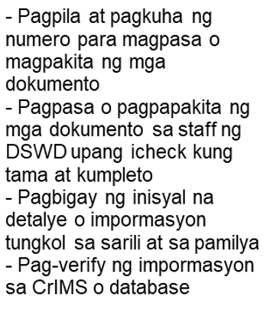
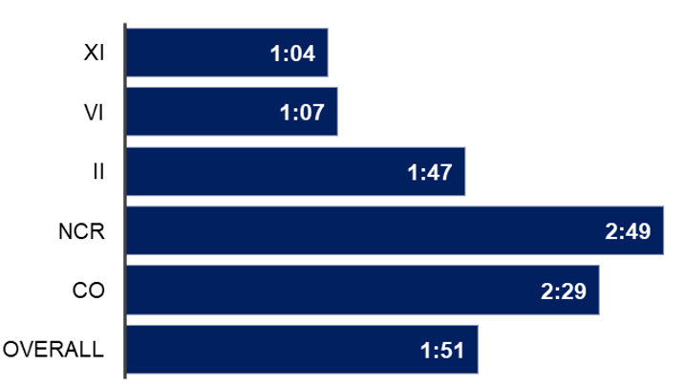
Processing Time
KEY FINDINGS
Step 1 Average Time Spent (in hours), per Region
PROCESS EVALUATION OF THE AICS
Notes:
Contrary to the 43-minute turnaround time based on SOP, the combined average time of steps under (1) screening and verification and (2) assessment/interview is around 3 hours and 56 minutes. The screening and verification steps take longer at 2 hours and 29 minutes on average than the assessment/interview steps at 1 hour and 27 minutes (see Figure 3 and 4).
One reason that the screening and verification steps take longer than the assessment is that there are times when the CrIMS has glitches and takes too long to load. When this happens, clients cannot proceed to the next steps and the queue gets a lot longer. On the other hand, a possible bottleneck before the assessment/interview steps is the filling out of the General Intake Sheet (GIS). While almost all or 92.5% of the survey respondents shared that they easily understood how to accomplish the GIS, some shared that the font size of the sheet is small. Respondents noticed that some clients had difficulty reading some texts and had to ask others to assist them in filling out the GIS.

Slide 29
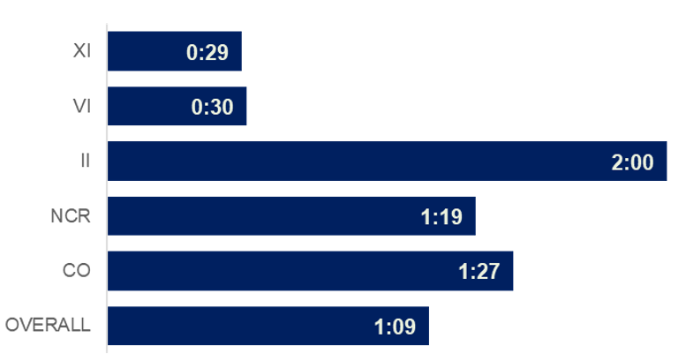
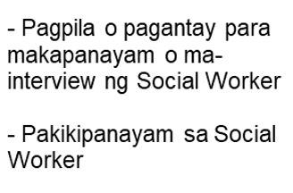
Processing Time
KEY FINDINGS
Step 2 Average Time Spent (in hours), per Region
PROCESS EVALUATION OF THE AICS
Notes:
Contrary to the 43-minute turnaround time based on SOP, the combined average time of steps under (1) screening and verification and (2) assessment/interview is around 3 hours and 56 minutes. The screening and verification steps take longer at 2 hours and 29 minutes on average than the assessment/interview steps at 1 hour and 27 minutes (see Figure 3 and 4).
One reason that the screening and verification steps take longer than the assessment is that there are times when the CrIMS has glitches and takes too long to load. When this happens, clients cannot proceed to the next steps and the queue gets a lot longer. On the other hand, a possible bottleneck before the assessment/interview steps is the filling out of the General Intake Sheet (GIS). While almost all or 92.5% of the survey respondents shared that they easily understood how to accomplish the GIS, some shared that the font size of the sheet is small. Respondents noticed that some clients had difficulty reading some texts and had to ask others to assist them in filling out the GIS.

Slide 30
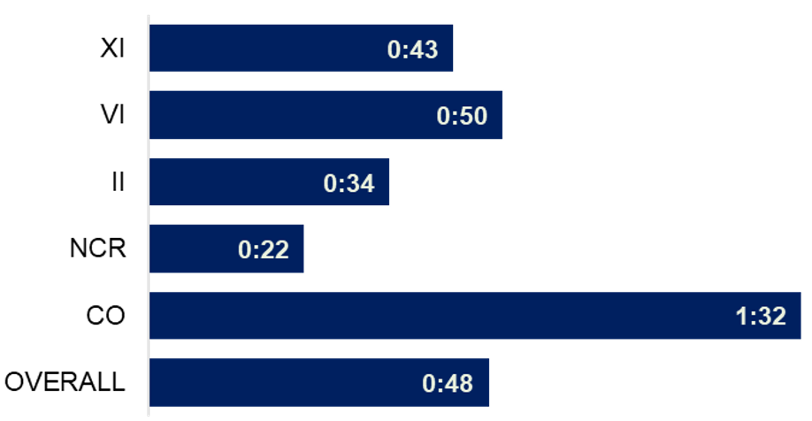
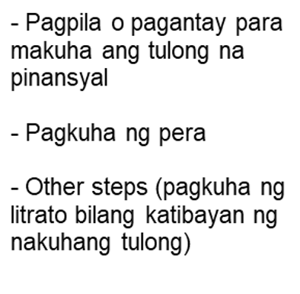
Processing Time
KEY FINDINGS
Step 3A Average Time Spent (in hours), per Region
PROCESS EVALUATION OF THE AICS
Notes:
The provision of outright cash which is the mode of assistance most prominent in Region II is second quickest among the research sites
at 34 minutes on average. Region II CIU also implements the taking of pictures of clients holding the assistance as the last step in the process. The photos are stored in the devices used by CIU staff. The program implementers shared that they were the first CIU who carried out this additional step to disprove the claims of some clients who deny receiving the assistance. While this discourages ineligible clients, there are no established mechanisms to ensure the data privacy of clients.

Slide 31
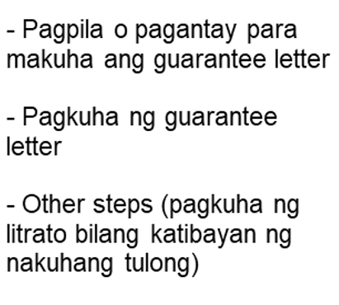
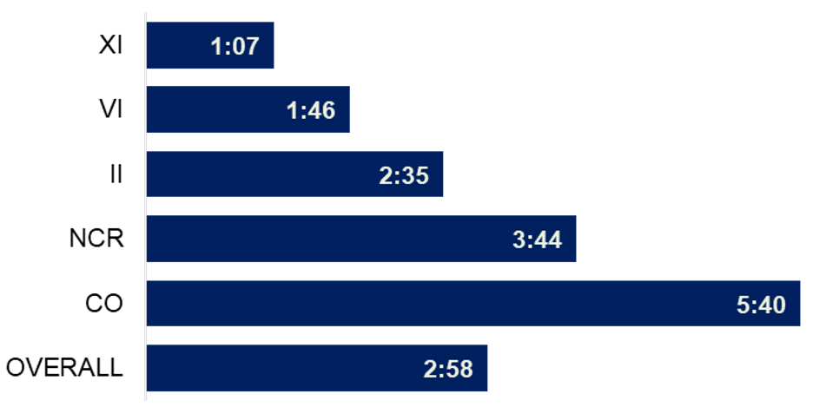
Processing Time
KEY FINDINGS
Step 3B Average Time Spent (in hours), per Region
PROCESS EVALUATION OF THE AICS
Notes:
The overall processing time in Region XI CIU is 2 hours and 16 minutes for outright cash and 2 hours and 40 minutes for GL. This is the fastest among all the research sites. Moreover, the percentage of clients having no difficulty in the process of availing AICS is also highest at 76.2%.

Slide 32
Average Amount of Assistance Received
KEY FINDINGS
Region | Cash | Guarantee Letter | Food/Non-Food Items
CO | 7,152.78 | 110,000.00 | -
NCR | 2,304.08 | 36,062.50 | -
Region II | 3,495.58 | 22,500.00 | -
Region VI | 7,471.01 | 18,333.33 | 7,333.33
Region XI | 5,218.14 | 18,449.30 | 3,000.00
Overall Average | 4,478.63 | 21,619.23 | 5,600.00
PROCESS EVALUATION OF THE AICS
Notes:
The amount of assistance received by the respondents differs depending on the form of assistance and availability of funds in the region. For outright cash, the amount of assistance ranges from Php2,304.08 (NCR) to Php7,152.78 (CO). Consistent with the program guidelines, assistance in the form of guarantee letters ranges from PhP18,333 (VI) to Php110,000 (CO).

Slide 33
Average Amount of Assistance Received
KEY FINDINGS
Region | Ave. Cost of Processing the AICS Requirements | Cash
CO | 370.88 | 7,152.78
NCR | 307.01 | 2,304.08
Region II | 340.55 | 3,495.58
Region VI | 538.22 | 7,471.01
Region XI | 286.04 | 5,218.14
Overall Average | 366.66 | 4,478.63
PROCESS EVALUATION OF THE AICS
Notes:
Another way of looking into the value of assistance provided to AICS clients is to compare their expenses during the processing of requirements with the actual amount of assistance.
Overall, the average cost of processing requirements is 8% of the total amount received in cash by the beneficiaries. The biggest percentage of expenses versus the average amount of assistance is observed in NCR at 13%.

Slide 34
Average Amount of Assistance Received
KEY FINDINGS
Cost vs. Amount Received, in Php
Area | Hospitalization |  | Dialysis and Chemotherapy |  | Laboratory Test |  | Medicine
 | Cost | Received | Cost | Received | Cost | Received | Cost | Received
CO | 361,227.30 | 56,666.67 | 11,285.71 | 10,000.00 | 19,142.86 | 7,666.67 | 8,916.67 | 6,027.78
NCR | 76,500.00 | 32,250.00 | 195,740.00 | 14,400.00 | 10,748.64 | 6,214.29 | 3,900.28 | 1,779.25
II | 100,000.00 | 12,500.00 | 9,000.00 | 5,000.00 | 15,610.00 | 2,900.00 | 4,434.68 | 3,306.25
VI | 72,278.53 | 17,500.00 | 35,250.00 | 13,000.00 | 6,126.67 | 5,166.67 | 4,780.30 | 4,854.84
XI | 147,375.00 | 30,574.07 | 23,142.86 | 8,228.57 | 5,800.00 | 5,250.00 | 7,831.71 | 6,301.63
Total | 125,680.60 | 27,298.08 | 51,729.63 | 9,944.00 | 11,735.86 | 5,700.00 | 5,039.55 | 3,629.42
PROCESS EVALUATION OF THE AICS
Notes:
Among the sub-types of medical assistance, the amount received by clients for medicines versus the cost of needs is highest at 72%. Meanwhile, the amount received for dialysis and chemotherapy versus the actual expenses is lowest at 19.2 %. The only case where the average amount received is higher than the average cost is observed in Region VI for the assistance for medicines.

Slide 35
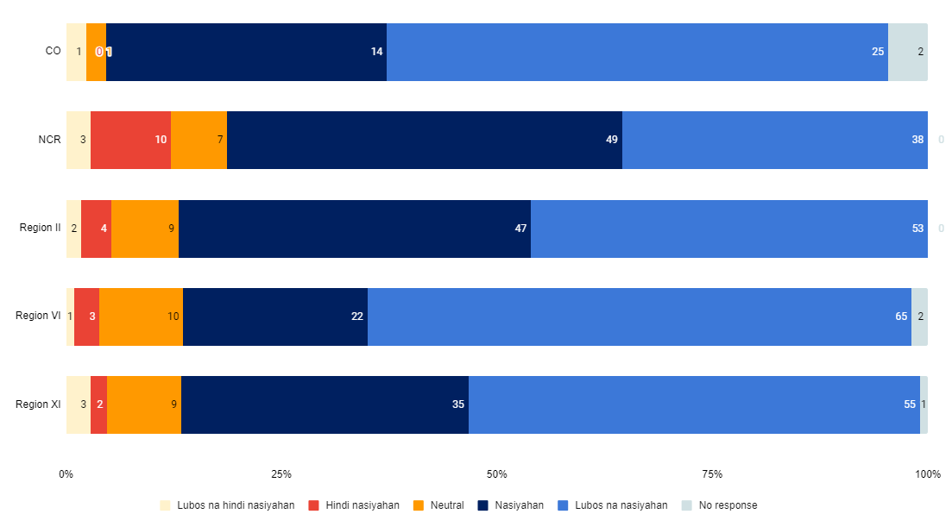
Level of Happiness on Amount of Assistance Received
KEY FINDINGS
PROCESS EVALUATION OF THE AICS
Notes:
Almost all of the respondents rated positively on the amount of assistance that they received.
Overall, 49% of the respondents expressed that they are extremely happy, 35% said they are happy; while only 2% of the respondents said that they are very unhappy with the amount of assistance they received.

Slide 36
Psychosocial Services
KEY FINDINGS
AICS Clients Provided Psychosocial Support
Area | No | Do not know | Yes | Total
CO | 42 | 0 | 1 | 43
NCR | 95 | 2 | 10 | 107
II | 90 | 1 | 24 | 115
VI | 55 | 26 | 22 | 103
XI | 82 | 4 | 19 | 105
Total | 364 | 33 | 76 | 473
PROCESS EVALUATION OF THE AICS
Notes:
Psychosocial support is given to help meet the psychological, emotional, social, and spiritual needs of clients/beneficiaries and their families to reduce the impact of stress brought by a crisis through behavioral modification interventions.
Almost all (94.1%) of the clients claimed that they were interviewed by the social worker. However, only 16.1% of them were able to recall that they received psychosocial support.

Slide 37
Referral System and After-Care Services
KEY FINDINGS
Clients Referred to Other Organizations
Organization | Percentage
LGUs | 53%
Philippine Charity Sweepstakes Office (PCSO) | 33%
House of Representatives | 28%
DSWD FOs | 7%
NGOs | 6%
PROCESS EVALUATION OF THE AICS
Notes:
As required by DSWD guidelines, the CIU social worker issues a referral letter to concerned FOs or LGU in favor of a client who needs AICS and other parochial/local services that should be catered thereby. For all other services of the Department, the social worker further, must refer the client to the bureau/ office implementing the program(s) that may respond to his/her need.
Survey results revealed that few (18.1%) respondents experienced referral from CIU social workers to other organizations. Majority (53.4%) claimed that they have been referred to LGUs and to Philippine Charity Sweepstakes Office (PCSO) (33%). Other respondents received a referral to the House of Representatives (28.4%), DSWD FOs (6.8%) and NGOs (5.7%).

Slide 38
Grievance Redress Mechanisms
KEY FINDINGS
AREA | Present |  | Not Present |  | Don't Know |  | Total
 | N | % | N | % | N | % | N | %
CO | 5 | 11.6 | 35 | 81.4 | 3 | 7 | 43 | 100
NCR | 12 | 11.3 | 71 | 67 | 23 | 21.7 | 106 | 100
II | 17 | 14.8 | 91 | 79.1 | 7 | 6.1 | 115 | 100
VI | 12 | 15.2 | 39 | 49.4 | 28 | 35.4 | 79 | 100
XI | 34 | 33 | 48 | 46.6 | 21 | 20.4 | 103 | 100
Overall | 80 | 17.9 | 284 | 63.7 | 82 | 18.4 | 446 | 100
PROCESS EVALUATION OF THE AICS
Notes:
When asked to recall the presence of any grievance redress system for the program, only 18% of the respondents said it was present.
They remember that submitting complaints or grievances was not clearly explained to them should a need arise. About 311 of the respondents or 73% mentioned that the grievance process is unclear to them.

Slide 39
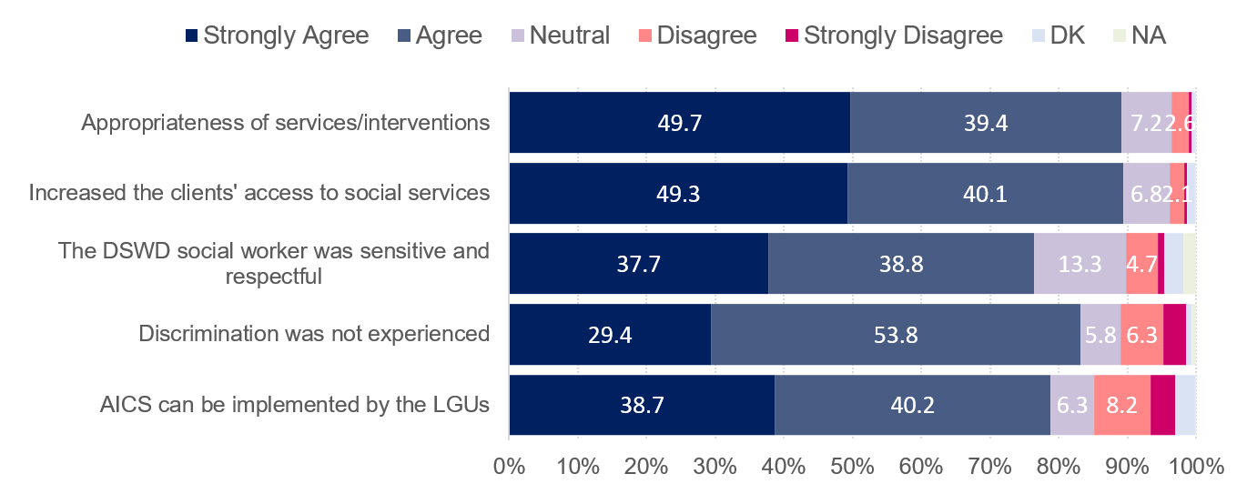
Relevance
KEY FINDINGS
Perception on the Relevance of AICS
PROCESS EVALUATION OF THE AICS
Notes:
Let me now discuss the findings by answering the key evaluation questions per evaluation criteria.
Relevance pertains to the extent an intervention is doing the right things. In the case of evaluating AICS, it covers the extent to which its objectives and design respond to beneficiaries’ needs, policies and priorities, and if it can continue to do so if circumstances change.
The survey results and qualitative data provide solid evidence that the AICS is able to respond to the needs of its beneficiaries. Based on the survey results in 90% of the survey participants perceived that the program is appropriate to their immediate needs and even increased their access to social services.

Slide 40
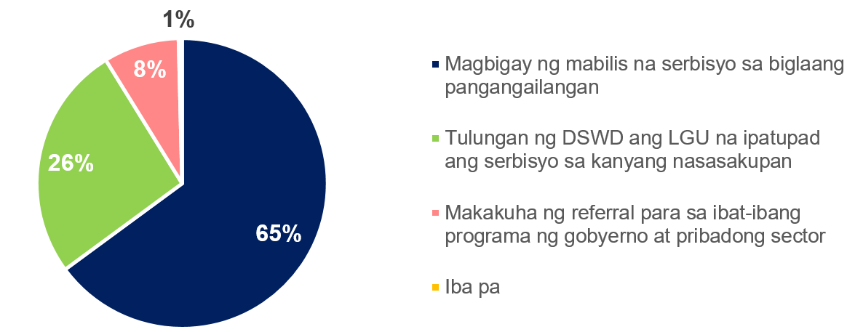
Relevance
KEY FINDINGS
Perceived Role of AICS
PROCESS EVALUATION OF THE AICS
Notes:
As designed, the AICS ensures the provision of direct financial and material assistance as well as psychosocial counselling and referral services. The survey respondents seem to agree when asked about what the role of AICS should be. A great majority or 65% answered that the AICS’ objective should be to provide immediate assistance during emergency situations.

Slide 41
Relevance
KEY FINDINGS
The objectives of AICS, as clearly stated in the Theory of Change, is strongly aligned with the needs and priorities of the clients/beneficiaries. The program remains ever relevant and responsive in the context of emergency or crisis situations because it offers a package of interventions to comprehensively address clients’ social welfare concerns.
PROCESS EVALUATION OF THE AICS
Notes:
As evidenced by qualitative and quantitative findings, the objectives of AICS, as clearly stated in the Theory of Change, is strongly aligned with the needs and priorities of the clients/beneficiaries. The program remains ever relevant and responsive in the context of emergency or crisis situations because it offers a package of interventions to comprehensively address clients’ social welfare concerns.
But while the program is able to address the needs of the clients/beneficiaries and thus obtains great support among stakeholders, its operations(use of resources and timeliness of service delivery among other) is also heavily influenced by program partners, specifically the elected national and local officials. These government officials want to bring closer the services under AICS to their constituents but in doing so affects the ownership of the program to some extent. Ethical issues arise when politicization bring about clientelism as it may impede equal and equitable access of clients to the program.
The AICS will remain vulnerable to clientelism because there will always be clients with immediate needs that can easily be persuaded in exchange of the financial assistance. These issues must definitely be addressed head on. On the other hand, the DSWD can definitely gain more from the interest and support that the AICS have gained over the years. The major challenge is how to effectively harness and manage these supports to sustain the program without sacrificing the integrity of the Department.

Slide 42
Effectiveness
KEY FINDINGS
Perception on the Effectiveness of AICS
PROCESS EVALUATION OF THE AICS
Notes:
The outcome objective of AICS is increased access of the poor and vulnerable sector to social welfare services. Majority of the clients of AICS indeed are considered poor. However, the Figure shows that more than 4 out of 5 respondents said that AICS can be availed by anyone, regardless of economic status. Based on the FGDs, the clients turned to DSWD due to their inability to pay for huge emergency expenses such as hospitalization and burial expenses. In most cases, regardless of their socio-economic condition, these emergencies have exhausted their resources and put their families into vulnerable situation. With the assistance from AICS, clients’ expenses have been substantially
reduced. Overall, the clients are thankful because the assistance provided an immediate relief from financial woes.

Slide 43
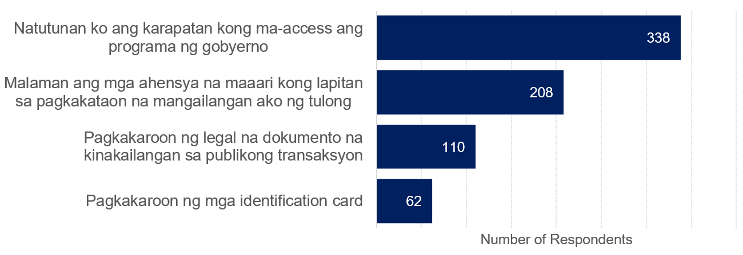
Effectiveness
KEY FINDINGS
Improvement on Client’s Capacity
PROCESS EVALUATION OF THE AICS
Notes:
In addition, the AICS has also been highly effective in terms of improving the capacity of the clients by increasing their knowledge on accessing government services

Slide 44
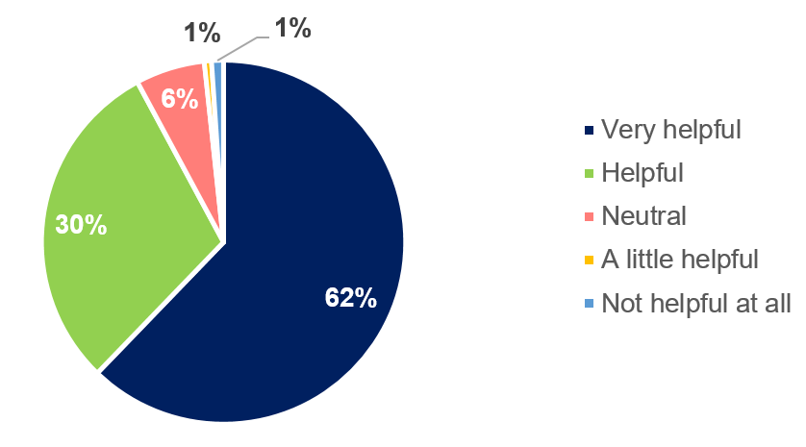
Effectiveness
KEY FINDINGS
Extent to which AICS had been helpful
PROCESS EVALUATION OF THE AICS
Notes:
Overall, AICS was generally viewed by the survey respondents as helpful in addressing their needs. More than 60% perceived AICS as very helpful, while 30% said it was helpful. Only around 2% felt that the program was not helpful.

Slide 45
Effectiveness
KEY FINDINGS
The effectiveness of AICS in delivering its activities and output and outcome objectives is clearly illustrated in the yearly overachievement of physical and financial targets, as well as high level of satisfaction of respondents on the overall process. However, the CIU/CIS should address the lengthy waiting and processing time, inappropriateness of assessment, inadequacy of amount of assistance, and inability to fully deliver the psychosocial support and referral services to clients.
PROCESS EVALUATION OF THE AICS
Notes:
The effectiveness of AICS in delivering its activities and output and outcome objectives is clearly illustrated in the yearly overachievement of physical and financial targets, as well as high level of satisfaction of respondents on the overall process. However, the CIU/CIS should address the lengthy waiting and processing time, inappropriateness of assessment, inadequacy of amount of assistance, and inability to fully deliver the psychosocial support and referral services to clients.
The effectiveness of AICS is also greatly affected by the lack of physical resources, hindered by issues along human resource and mired by the large budget to be managed and disbursed.

Slide 46
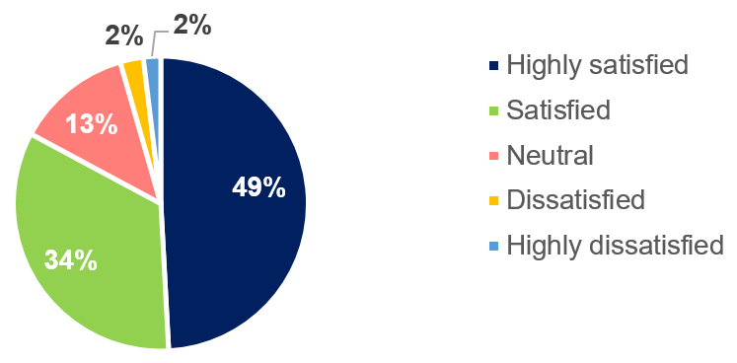
Efficiency
KEY FINDINGS
Overall Satisfaction on the Process
PROCESS EVALUATION OF THE AICS
Notes:
Overall, the majority of the survey respondents are satisfied with the processes they experienced. Nearly 50% of the respondents are highly satisfied, while 34% are satisfied. On the other hand, only 4% reported dissatisfaction about the process

Slide 47
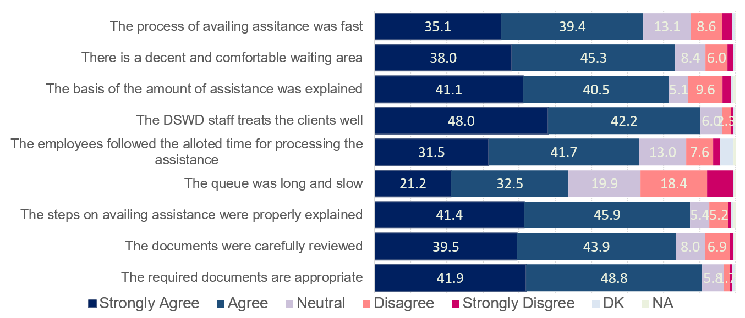
Efficiency
KEY FINDINGS
Perception on the Efficiency of AICS
PROCESS EVALUATION OF THE AICS
Notes:
Overall, a moderate proportion of clients or 74% perceived that the processes on availing the assistance was fast based on the survey results.
When the clients were asked about their perception about the lines and queueing system, the satisfaction was seemingly lower. In fact, more than half of the respondents reported that the queue was long and slow-moving. This result is consistent with the findings of the previous section, wherein the clients wait for around 3-5 hours on the average before they can proceed with Step 1. During the FGDs, some of the clients expressed their concerns on safety of clients who are lining up too early (as early as 1AM) since only limited clients will be accepted per day for availing AICS. According to the clients, this puts them into a risky condition, especially the elderly, women and children who are staying overnight outside the CIU to secure a slot for the AICS. Moreover, this entails additional stress to their already stressful condition. Lastly, a relatively lower proportion, 73%, felt that the employees followed the allotted time for processing the assistance.

Slide 48
Efficiency
KEY FINDINGS
The time spent in processing the assistance is essential in determining the operational efficiency of the AICS. Despite the long queues, the respondents are mostly satisfied with the time spent in processing the assistance. In terms of economic efficiency, the financial assistance is insufficient for most of the clients and cannot cover the full amount of their expenses. Regardless of the amount, however, the clients perceived that the AICS was very helpful in augmenting their financial resources.
PROCESS EVALUATION OF THE AICS

Slide 49
Efficiency
KEY FINDINGS
Along operational efficiency, the implementation of AICS is hindered by issues along human resource (major dependency on hiring of contract of service workers who do not have job tenure, high client to staff ratio, and inadequacy of capability building activities). Service delivery is also greatly affected by the lack of physical resources (such as space for CIU/CIS operations, office space for staff, service vehicles, stable and operational ICT system and infrastructure, and office equipment such as laptops/desktops, printers, and photocopy machines).
PROCESS EVALUATION OF THE AICS

Slide 50
Efficiency
KEY FINDINGS
The approval process of amount of assistance to be provided to clients can be argued as efficient because the financial accountability is clearly distributed among the authorized officials. On the other hand, inefficiencies in the distribution of outright cash usually stem from either lack of Special Disbursement Officers (SDO) or delays in liquidation.
PROCESS EVALUATION OF THE AICS

Slide 51
Coherence
KEY FINDINGS
Internal and external coherence is still lacking in AICS because there is no efficient referral process within and outside the Department’s social welfare services. Consequently, duplication of services from among the different possible sources of assistance is also inevitable due to insufficiency of assistance provided and non-existence of harmonized database system of the different social welfare services.
PROCESS EVALUATION OF THE AICS
Notes:
Incoherent interventions may be duplicative, thus wasting resources. In the case of AICS, internal coherence is still lacking because there is no efficient referral process within and outside the Department’s social welfare services. Consequently, duplication of services from among the different possible sources of assistance is also inevitable as there is no existing harmonized database system of the different social welfare services. Policy incoherence is also not evident among the different guidelines covering the social welfare services of LGUs and national agencies, as policies usually cover only the particular program/service and the institution itself.

Slide 52
Coherence
KEY FINDINGS
Perception on the Coherence of AICS
PROCESS EVALUATION OF THE AICS
Notes:
Based on the perceptions of clients and beneficiaries, although most of them agreed (24.3% and 26.5%) and strongly agreed (31.3% and 32.5%) that there is clear coordination between DSWD and private institutions and other government institutions, there is also significant number of clients who are not aware (22.4% and (21.2%) and exposed (11.7% and 11.5%) of the coordination between these institutions.

Slide 53
Potential Impact
KEY FINDINGS
Major findings of the study support the impact of AICS to the lives of clients who were provided assistance for their immediate needs. Among the possible unintended effects of AICS that was documented are development of clients’ dependency on government assistance, risk reduction of clients’ tendency to commit crimes or illegal work, empowerment of beneficiaries to access social welfare services, and fostering of sense of fulfillment for program implementers.
PROCESS EVALUATION OF THE AICS
Notes:
Given the definition of the program as a stop-gap mechanism to support the recovery of individuals and families from unexpected life events or crises, major findings of the study support the impact of AICS to the lives of clients who were provided assistance for their immediate needs. It must be noted however that the discontent of respondents is most evident in the narratives of clients with chronic diseases who are usually only given assistance that is good for one month of medication. Among the possible unintended effects of AICs that was documented are development of clients’ dependency on government assistance, risk reduction of clients’ tendency to commit crimes or illegal work, empowerment of beneficiaries to access social welfare services, and fostering of sense of fulfillment for program implementers.

Slide 54
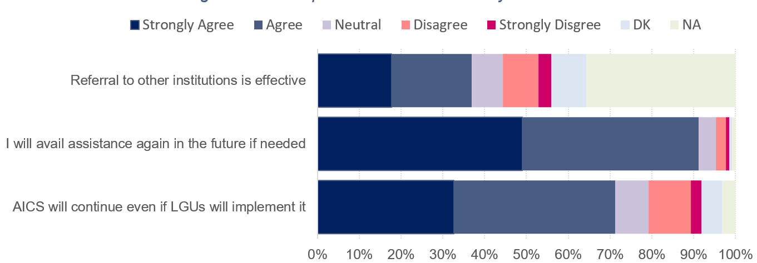
Sustainability
KEY FINDINGS
Perception on the Sustainability of AICS
PROCESS EVALUATION OF THE AICS
Notes:
The following figure presents how sustainability of AICS was perceived by the clients/beneficiaries. Based on the results, more than 90% of the clients said that they will avail assistance again from AICS, should they need it in the future. In the majority of cases, the respondents hoped for continued implementation of AICS because they heavily rely on government assistance to support their needs. In the short-run, AICS provides immediate relief, but its net benefits extend in the long run because it raises the knowledge and capacity of clients in handling difficult situations. Overall, it empowered the clients to demand for government assistance and services. AICS served as a stepping-stone to access other social protection programs of the government.
When asked if the AICS will continue even if LGUs will implement it, the clients appeared to have reservations about it. During the FGD sessions, a common reason cited for this is that political influence is inevitable. Moreover, some said that DSWD has relatively more objective mechanisms and processes for the provision of financial assistance.

Slide 55
Sustainability
KEY FINDINGS
The AICS is generally perceived as helpful and should be continuously implemented by DSWD.
In terms of establishing partnerships to sustain the benefits of AICS, there is a need for more communication strategies that will raise the clients’ awareness of other services offered by the government.
There are varying opinions among program implementers along discussions of full devolution of the program to the LGUs.
PROCESS EVALUATION OF THE AICS
Notes:
For sustainability, the AICS is generally perceived by the majority of survey respondents and FGD participants as helpful and should be continuously implemented by DSWD. In terms of establishing partnerships to sustain the benefits of AICS, there is a need for more communication strategies that will raise the clients’ awareness of other services offered by the government. There are varying opinions among program implementers along discussions of full devolution of the program to the LGUs. Some believe that the DSWD should continue implementing the AICS, especially now that there are efforts from the legislators to institutionalize the program. Politicization of the program through clientelism is also a concern
if the AICS is devolved to the LGUs. On the other hand, others believe that it is better to implement the program at the LGU level as long as DSWD will continuously conduct technical assistance to the LGUs. The role of the DSWD according to them is to only set standards through regulatory functions.

Slide 56
KEY RECOMMENDATIONS
PROCESS EVALUATION OF THE AICS
Notes:
As evidenced by the findings, there are several program issues, challenges and gaps that have to be addressed by the Department to be able to continuously provide social welfare interventions through the AICS Program. The following are recommended for policy and program enhancement of the AICS:

Slide 57
On Program Guidelines, Procedures and Policies
KEY RECOMMENDATIONS
Revisit the existing policy/guidelines, particularly along the following areas:
Consider setting a standard amount of assistance which can be given in full based on the actual needs of the clients/beneficiaries to avoid inappropriateness or inadequacy of assistance.
Clearly state in the guidelines the regulations for creation of contracts or Memorandum of Agreements with service providers to provide at least minimum standard roles and responsibilities for the department and the service provider.
PROCESS EVALUATION OF THE AICS
Notes:
Consider setting a standard amount of assistance which can be given in full based on the actual needs of the clients/beneficiaries to avoid inappropriateness or inadequacy of assistance. The amount of assistance should be based on actual needs of the client/beneficiary which can be formulated by citing specific criteria or concrete indicators of their vulnerability. The amount should also take major consideration of their socio-economic conditions within the context of macro- (e.g., demand, inflationary, and monetary policy shocks) and micro-economic (health, income, and consumption shocks) shocks.
Clearly state in the guidelines the regulations for creation of contracts or Memorandum of Agreements with service providers to provide at least minimum standard roles and responsibilities for the department and the service provider. The regulation should also warrant the inclusion of realistic timelines for processing of payment by the Department. Moreover, a monitoring system and mechanisms for quick feedbacking between service providers and DSWD should be established to ensure adherence to the processing timeline should be strictly monitored and ensured by the Department.

Slide 58
On Program Guidelines, Procedures and Policies
KEY RECOMMENDATIONS
Aside from identifying measures on how to respond to and process grievances, cascade, explain and readily make accessible the concept and mechanism of handling grievances and complaints to clients.
Provide referral service to the clients/beneficiaries depending on the case management or assessment results of the social worker.
Review if the documentary requirements can be further minimized to reduce processing time and cost from the part of clients.
PROCESS EVALUATION OF THE AICS
Notes:
Aside from identifying measures on how to respond to and process grievances, cascade, explain and readily make accessible the concept and mechanism of handling grievances and complaints to clients.
Provide referral service to the clients/beneficiaries depending on the case management or assessment results of the social worker. As stated in the ToC of AICS, the referral services should not be limited to providing assistance when the requested support is not within the range of AICS or DSWD services. Further, if clients/beneficiaries would be properly referred to appropriate services, their dependency on the financial assistance from AICS could be lessened.
Documentary requirements, though already minimized, are required as support to the amount being requested by the client/beneficiary. Hence, if the amount to be provided by the office would be standardized, the documents should be further minimized particularly eliminating documents related to cost or amount of service – such as funeral contracts, and statement of accounts, as it only adds to the timeline and even cost of processing the requested assistance.

Slide 59
On Program Guidelines, Procedures and Policies
KEY RECOMMENDATIONS
Revisit the maximum frequency of availment especially for medical assistance for medicines, laboratory and other procedures.
Implement nationwide a standard quota system considering the human resource and financial capacity of each office.
Include the adoption of the framework/Theory of Change of AICS in the guidelines as the backbone of the policy.
PROCESS EVALUATION OF THE AICS
Notes:
Revisit the maximum frequency of availment especially for medical assistance for medicines, laboratory and other procedures. Clients with chronic diseases for example should be excluded from the limit of once every three months.
Implement nationwide a standard quota system considering the human resource and financial capacity of each office. As observed in all study sites, the quota system is already being done as it is seen as crucial strategy to maintain the daily operations of AICS.
Include the adoption of the framework/Theory of Change of AICS in the guidelines as the backbone of the policy. This shall provide the description and illustration of how and why we desire our goals to happen. Further, gender and development perspectives should be incorporated into the framework for a more holistic approach in the provision of AICS

Slide 60
On Human Resource
KEY RECOMMENDATIONS
Hire additional staff as needed to maintain a reasonable client to staff ratio.
Provide customer service-related capability building/trainings to AICS implementers.
For the longer term, provide security of tenure and regularize all of the COS workers.
PROCESS EVALUATION OF THE AICS
Notes:
Hire additional staff as needed to maintain a reasonable client to staff ratio. The lack of human resource leads to lower quality of service and additional requirements or processes on the part of the clients. Ensure the welfare of the staff provided that most are hired as Cost of Service (COS) workers. Proper compensation should also be provided to workers who provide overtime services. Aside from Social Workers, enough number of Special Disbursement Officers (SDOs) per operating office should also be ensured since it affects the utilization and disbursement rate
Provide customer service-related capability building/trainings to AICS implementers. As the DSWD staff encounter different type of individuals requesting for AICS assistance, the Department should train the staff including the security guards and housekeepers, who play major roles in the day-to-day operations of AICS. Gender sensitivity trainings should also be conducted to heighten the awareness of staff on gender issues and enable them to respond appropriately to clients and provide equitable service at all times.
For the longer term, provide security of tenure and regularize all of the COS workers since provision of AICS has become one of the biggest services of the department and has been operating for quite a long period of time.

Slide 61
On ICT and Other Physical Resources
KEY RECOMMENDATIONS
Allocate additional budget for office equipment and internet connection to quicken the processing of requests.
Ensure budget allocation for facilities, office space, and service vehicles, including the maintenance costs of the said resources to be able to provide dignified and good quality service to clients.
Assess the readiness of AICS on digital payments at three levels – beneficiary, institutional and system levels.
PROCESS EVALUATION OF THE AICS
Notes:
Allocate additional budget for office equipment and internet connection to quicken the processing of requests. Explore the installation of integrated and automated queuing system to better manage client traffic. Also, each AICS staff/implementer should have their own laptop/desktops for processing of requests as well as enough number of printers, scanners and photocopiers to ease the documentation of the AICS requests. Consider providing free photocopying service for the clients to lessen the cost of processing the requirements for assistance.
Ensure budget allocation for facilities, office space, and service vehicles, including the maintenance costs of the said resources to be able to provide dignified and good quality service to clients.
The CIU/CIS facilities should be secure, large enough to accommodate the clients, weatherproof, and with ample seating capacity and good ventilation. The office space for the CIU/CIS staff should be conducive for work and secure enough for the staff handling large
amount of money.
The facilities should also be accessible and consider the mobility needs of the elderly, PWDs and other clients with special conditions. Require all CIU/CIS to install standard wayfinding signs to reduce confusion, increase safety, and help people find their way while inside the DSWD premises.
The provision of well-maintained service vehicles can give security to the AICS implementers especially when they travel in geographically isolated and disadvantaged areas during off-site payouts.
Since all of these would entail bigger costs, these could be planned and requested for the long-term implementation plan of AICS.

Slide 62
On Planning and Budgeting
KEY RECOMMENDATIONS
Revisit and improve the targeting and budgeting mechanisms of AICS, to ensure that the allocated budget for the program corresponds to the requested/proposed budget.
PROCESS EVALUATION OF THE AICS
Notes:
Revisit and improve the targeting and budgeting mechanisms of AICS, to ensure that the allocated budget for the program corresponds to the requested/proposed budget which is based on the historical data of clients served by the AICS. This way, the AICS implementers could have a strategic work planning of their targets for the year, and the Department could provide timely and accurate monitoring of accomplishments. With proper work planning also, the available human resource could efficiently operate to provide quality service to the clients/beneficiaries.

Slide 63
On Monitoring and Evaluation
KEY RECOMMENDATIONS
Strengthen the use of Crisis Intervention Monitoring System (CrIMS) for data capturing and as a monitoring tool.
Conduct regular operational spot-checks to help monitor the gaps and issues on AICS implementation.
Conduct of nationwide evaluation covering more cities and municipalities can establish more relevant findings and recommendations which would help improve the overall services of the program.
PROCESS EVALUATION OF THE AICS
Notes:
Strengthen the use of the Crisis Intervention Monitoring System (CrIMS) for data capturing and as a monitoring tool. Although the CrIMS is already implemented, the recurrent outage of the system disrupts the operations of the CIU/CIS. This should be completely resolved by enhancing the existing system or adopting a new and upgraded system. Moreover, disaggregation of data and information by sex, age, gender, religion, ethnicity, and disability should be incorporated in the data capturing and monitoring system. In doing this, the Department will be able to fully comply with Executive Order No. 100 s. 2019 (Inter-Agency Committee on Diversity and Inclusion and for Other Purposes), of which the DSWD is the Vice-Chairperson for the said inter-agency committee.
Conduct regular operational spot-checks to help monitor the gaps and issues on AICS implementation. Regular conduct of spot-checks will ensure that the guidelines are properly implemented at the field level. It will also help resolve existing gaps and issues more efficiently since actual practice would be observed. Good practices on AICS implementation would also be easily gathered through spot-checks as well as serve as regular monitoring for the field office especially in terms of submission of reports and accomplishments. Technical assistance on certain areas of implementation can also be conducted immediately after the presentation of the findings of spot-check.
Conduct nationwide evaluation covering more cities and municipalities to improve the reliability and validity of the evaluation. This study covered only selected regional offices and selected cities/ municipalities which limits the generalization of the findings. Gender lens should also be applied to the evaluation criteria in order to consider how power dynamics based on gender intersect and interact with other forms of discrimination to affect the implementation and results of AICS.

Slide 64
On Other AICS Components
KEY RECOMMENDATIONS
Review and strengthen the provision of psychosocial support and case management to be able to fully implement these components as part of the provision of AICS.
PROCESS EVALUATION OF THE AICS
Notes:
Review and strengthen the provision of psychosocial support and case management to be able to fully implement these components as part of the provision of AICS. The provision of psychosocial support to individuals and families in crisis situations is essential in helping them process the discomfort, pain, and other unpleasant feelings they are going through. This would entail hiring of additional psychologists or social workers who can provide direct psychosocial support to clients or conduct capability building for existing AICS implementers.
Moreover, social case management should be provided considering the multiple and complex needs of the clients to help optimize their functioning. Extending other social protection programs to the AICS clients through case management would help sustain their needs, other than the immediate assistance requested.

Slide 65
On Stakeholder Engagement
KEY RECOMMENDATIONS
Institutionalize mechanisms for convergence of AICS with other social protection programs and services of the DSWD and other government and non-government agencies.
Intensify the Information, Education, and Communication (IEC) campaigns in order to increase the reach of the program and raise the awareness and knowledge of the target clients.
PROCESS EVALUATION OF THE AICS
Notes:
Institutionalize mechanisms for convergence of AICS with other social protection programs and services of the DSWD and other government and non-government agencies. While the DSWD provides integrated and comprehensive social protection programs, the Department should not be alone in this endeavour. Other government agencies such as the Senate, Congress, the Executive Departments and local governments also have roles and responsibilities in social protection. The civil society, academe and even program beneficiaries also play important roles in identifying and attending to the needs of the poor and alleviating their difficulties.
Initially, the program implementers should conduct stakeholder mapping to provide an overview of the roles of other partners and the range of programs and services that are similar to the AICS. The DSWD should lead formal discussions, especially with partner legislators on how the different stakeholders maximize resources, avoid duplication of efforts, and enhance operational and financial efficiency for the sustainability of desired outcomes. The Department should also stand its ground in providing equitable service to all the clients, without prejudice to any political leanings.
Intensify the Information, Education, and Communication (IEC) campaigns to increase the reach of the program and raise the awareness and knowledge of the target clients. With the existence of effective IEC materials, misconceptions about AICS as well as unnecessary processes and interventions would be lessened provided that clients would be fully-aware and empowered on the program rules and regulations. These strong information channels & dissemination strategies should be disseminated within the DSWD down to the barangay level for accessibility purposes. Further, initiatives to bring the services of AICS closer to clients, particularly women, would help alleviate the multiple burdens of women, as they find ways to resolve their crises.

Slide 66
Thank you for your attention!
Policy and Plans Group Cluster Meeting
13 July 2021, 8:00AM
Meeting link:
11 February 2022
24 January 2023 Via Google Meet

Slide 67
PROCESS EVALUATION OF THE ASSISTANCE TO INDIVIDUALS IN CRISIS SITUATION (AICS)
Policy and Plans Group Cluster Meeting
13 July 2021, 8:00AM
Meeting link:
24 January 2023 Via Google Meet

Slide 68
OPEN FORUM
PROCESS EVALUATION OF THE AICS

Slide 69
PROCESS EVALUATION OF THE ASSISTANCE TO INDIVIDUALS IN CRISIS SITUATION (AICS)
Policy and Plans Group Cluster Meeting
13 July 2021, 8:00AM
Meeting link:
24 January 2023 Via Google Meet

